Slide 1


Slide 2
Smart Fraud Detection & Analysis

Slide 3
TEAM INSTRUCTOR

Slide 4
TEAM INSTRUCTOR
Abdullah Mahmoud

Slide 5
TEAM INSTRUCTOR
Abdullah Mahmoud
TEAM MEMBERS
Abdalrahman Daif
Amr Zain
Salma Magdy
Somaia Osama
Rawda Fadel
Hager Reda

Slide 6
TEAM INSTRUCTOR
Abdullah Mahmoud
TEAM MEMBERS
Abdalrahman Daif
Amr Zain
Salma Magdy
Somaia Osama
Rawda Fadel
Hager Reda

Slide 7
TEAM INSTRUCTOR
Abdullah Mahmoud
TEAM MEMBERS
Abdalrahman Daif
Amr Zain
Salma Magdy
Somaia Osama
Rawda Fadel
Hager Reda

Slide 8
TEAM INSTRUCTOR
Abdullah Mahmoud
TEAM MEMBERS
Abdalrahman Daif
Amr Zain
Salma Magdy
Somaia Osama
Rawda Fadel
Hager Reda

Slide 9

Project Overview (Fraud Detection)
Full End-to-End Fraud Detection and Analysis system,
Our project is designed to handle the entire data lifecycle—from
data collection and storage, through transformation and orchestration, to
advanced analytics. By integrating databases, data warehouses, and
automated ETL pipelines, we ensure that raw data is transformed into
meaningful insights efficiently and reliably.

Slide 10
Object Overview (Fraud Detection)
The system extends further with real-time streaming using Airflow,
machine learning models, and cloud deployment, culminating in a
user-friendly web interface. This comprehensive setup allows users and
organizations to detect and prevent fraudulent activities in real time,
making informed, secure, and data-driven decisions with confidence.

Slide 11
Object Overview (Fraud Detection)
Tools:-
Python - SSMS
SSIS - Airflow
Power BI - Spark
Azure
HTML
CSS
Java Script

Slide 12


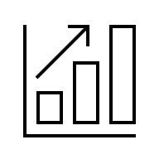
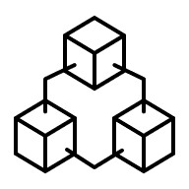

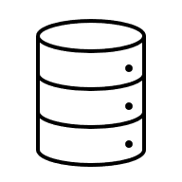
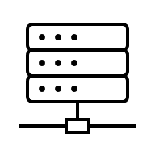
8
AMAN
1
Developed a user-friendly web interface
DATA COLLECTION
Collected and cleaned data from multiple sources.
7
2
CLOUD
DATABASE DESIGN
MILESTONES
Deployed the system on Azure to ensure scalability, reliability
Designed schema and created ERD for structured storage.
3
6
DATA WAREHOUSE
MACHINE LEARNING
Built a centralized warehouse for analytical purposes.
Developed a model to detect fraudulent transactions.
4
5
DATA ORCHESTRATION
DATA ANALYSIS
Automated ETL pipelines using Apache Airflow.
Visualized insights and results through interactive dashboards.

Slide 13
MILESTONES
8
AMAN
1
Developed a user-friendly web interface
DATA COLLECTION
Collected and cleaned data from multiple sources.
7
2
CLOUD
DATABASE DESIGN
Deployed the system on Azure to ensure scalability, reliability
Designed schema and created ERD for structured storage.
3
6
DATA WAREHOUSE
MACHINE LEARNING
Built a centralized warehouse for analytical purposes.
Developed a model to detect fraudulent transactions.
4
5
DATA ORCHESTRATION
DATA ANALYSIS
Automated ETL pipelines using Apache Airflow.
Visualized insights and results through interactive dashboards.

Slide 14
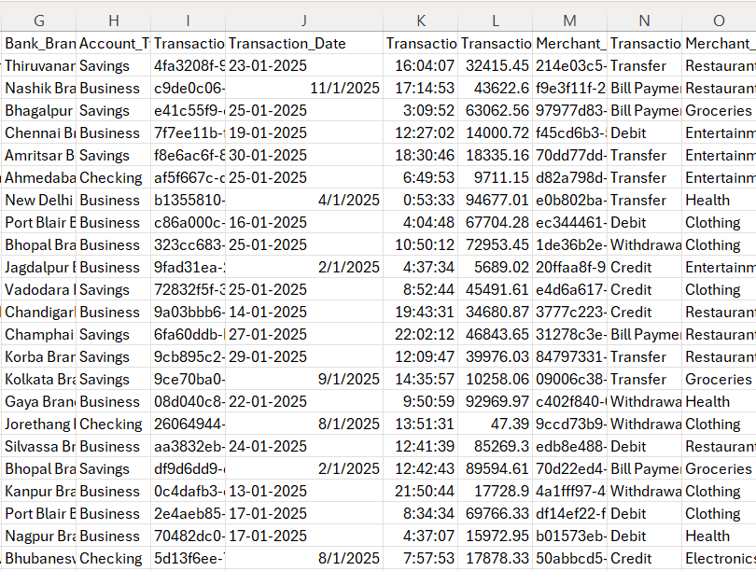
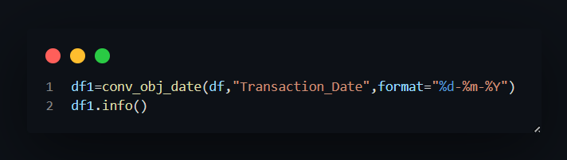
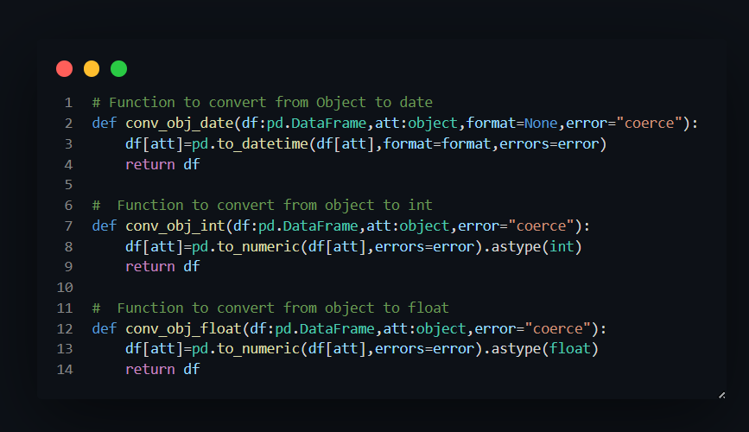
MILESTONES
1
8
DATA COLLECTION
AMAN
Developed a user-friendly web interface
In this phase, we collected raw transaction data from multiple sources like(Kaggle,..) and imported it
into Excel for initial exploration.
- We cleaned the data by handling missing values,
removing duplicates, and formatting inconsistent
fields
- Tools:-
Python liberaries:-
- Pandas - NumPy
were used to automate the cleaning process before
loading the data into the database.
7
2
CLOUD
DATABASE DESIGN
Deployed the system on Azure to ensure scalability, reliability
Designed schema and created ERD for structured storage.
3
6
DATA WAREHOUSE
MACHINE LEARNING
Built a centralized warehouse for analytical purposes.
Developed a model to detect fraudulent transactions.
4
5
DATA ORCHESTRATION
DATA ANALYSIS
Automated ETL pipelines using Apache Airflow.
Visualized insights and results through interactive dashboards.

Slide 15
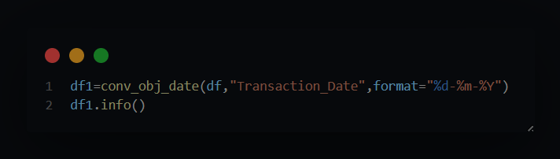
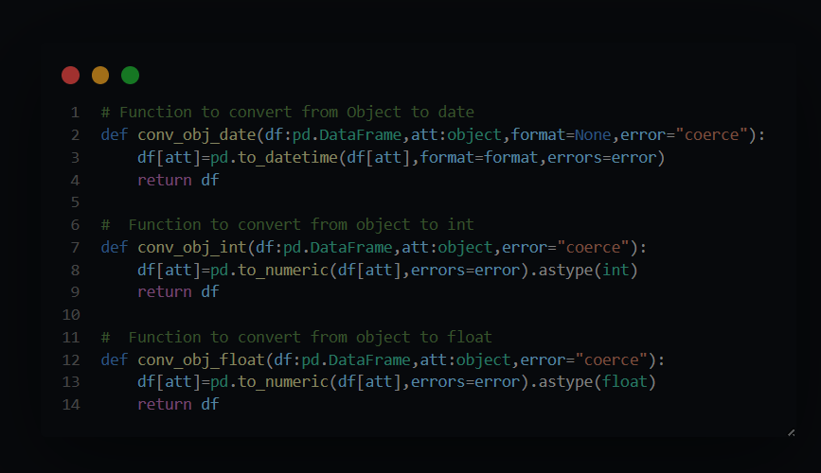
MILESTONES
1
8
DATA COLLECTION
AMAN
Developed a user-friendly web interface
In this phase, we collected raw transaction data from multiple sources like(Kaggle,..) and imported it
into Excel for initial exploration.
- We cleaned the data by handling missing values,
removing duplicates, and formatting inconsistent
fields
- Tools:-
Python liberaries:-
- Pandas - NumPy
were used to automate the cleaning process before
loading the data into the database.
7
2
CLOUD
DATABASE DESIGN
Deployed the system on Azure to ensure scalability, reliability
Designed schema and created ERD for structured storage.
3
6
DATA WAREHOUSE
MACHINE LEARNING
Built a centralized warehouse for analytical purposes.
Developed a model to detect fraudulent transactions.
4
5
DATA ORCHESTRATION
DATA ANALYSIS
Automated ETL pipelines using Apache Airflow.
Visualized insights and results through interactive dashboards.

Slide 16

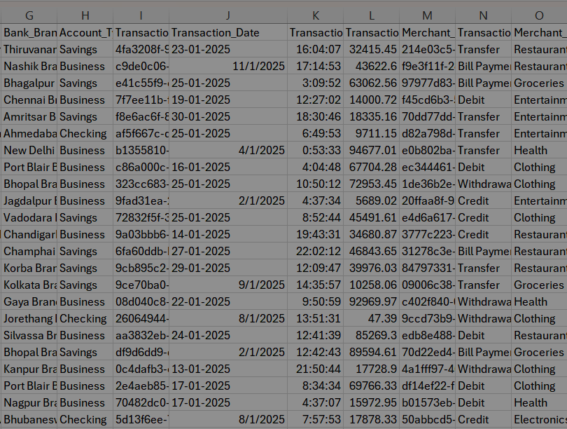
MILESTONES
6
1
8
MACHINE LEARNING
DATA COLLECTION
AMAN
Developed a model to detect fraudulent transactions.
Developed a user-friendly web interface
In this phase, we collected raw transaction data from multiple sources like(Kaggle,..) and imported it
into Excel for initial exploration.
- We cleaned the data by handling missing values,
removing duplicates, and formatting inconsistent
fields
- Tools:-
Python liberaries:-
- Pandas - NumPy
were used to automate the cleaning process before
loading the data into the database.
7
5
2
CLOUD
DATA ANALYSIS
DATABASE DESIGN
Deployed the system on Azure to ensure scalability, reliability
Visualized insights and results through interactive dashboards.
Designed schema and created ERD for structured storage.
3
6
DATA WAREHOUSE
MACHINE LEARNING
4
Built a centralized warehouse for analytical purposes.
Developed a model to detect fraudulent transactions.
DATAORCHESTRATION
4
5
Automated ETL pipelines using Apache Airflow.
DATA ORCHESTRATION
DATA ANALYSIS
Automated ETL pipelines using Apache Airflow.
Visualized insights and results through interactive dashboards.

Slide 17
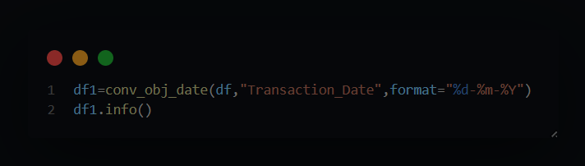
MILESTONES
1
8
DATA COLLECTION
AMAN
Developed a user-friendly web interface
In this phase, we collected raw transaction data from multiple sources like(Kaggle,..) and imported it
into Excel for initial exploration.
- We cleaned the data by handling missing values,
removing duplicates, and formatting inconsistent
fields
- Tools:-
Python liberaries:-
- Pandas - NumPy
were used to automate the cleaning process before
loading the data into the database.
7
2
CLOUD
DATABASE DESIGN
Deployed the system on Azure to ensure scalability, reliability
Designed schema and created ERD for structured storage.
3
6
DATA WAREHOUSE
MACHINE LEARNING
Built a centralized warehouse for analytical purposes.
Developed a model to detect fraudulent transactions.
4
5
DATA ORCHESTRATION
DATA ANALYSIS
Automated ETL pipelines using Apache Airflow.
Visualized insights and results through interactive dashboards.

Slide 18
MILESTONES
6
1
MACHINE LEARNING
DATA COLLECTION
Developed a model to detect fraudulent transactions.
In this phase, we collected raw transaction data from multiple sources like(Kaggle,..) and imported it
into Excel for initial exploration.
- We cleaned the data by handling missing values,
removing duplicates, and formatting inconsistent
fields
- Tools:-
Python liberaries:-
- Pandas - NumPy
were used to automate the cleaning process before
loading the data into the database.
5
2
DATA ANALYSIS
DATABASE DESIGN
Visualized insights and results through interactive dashboards.
Designed schema and created ERD for structured storage.
3
DATA WAREHOUSE
4
Built a centralized warehouse for analytical purposes.
DATAORCHESTRATION
4
Automated ETL pipelines using Apache Airflow.
DATA ORCHESTRATION
Automated ETL pipelines using Apache Airflow.

Slide 19
MILESTONES
8
AMAN
1
Developed a user-friendly web interface
DATA COLLECTION
Collected and cleaned data from multiple sources.
7
2
CLOUD
DATABASE DESIGN
Deployed the system on Azure to ensure scalability, reliability
Designed schema and created ERD for structured storage.
3
6
DATA WAREHOUSE
MACHINE LEARNING
Built a centralized warehouse for analytical purposes.
Developed a model to detect fraudulent transactions.
4
5
DATA ORCHESTRATION
DATA ANALYSIS
Automated ETL pipelines using Apache Airflow.
Visualized insights and results through interactive dashboards.

Slide 20
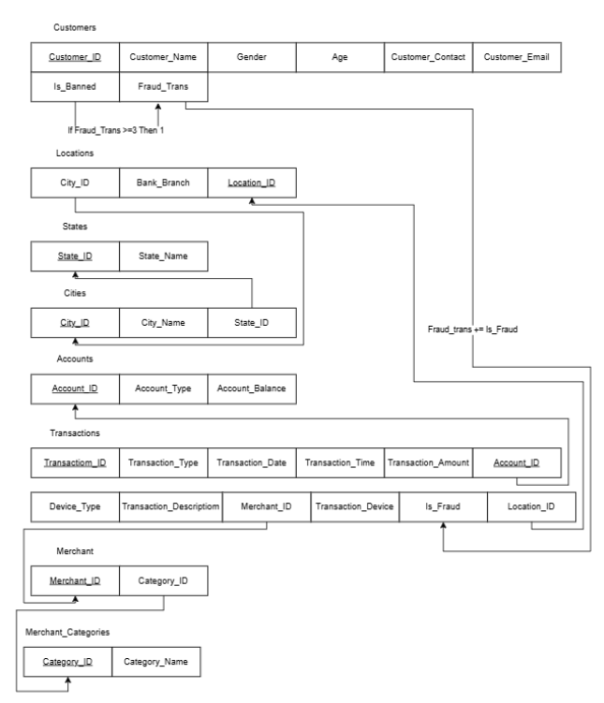
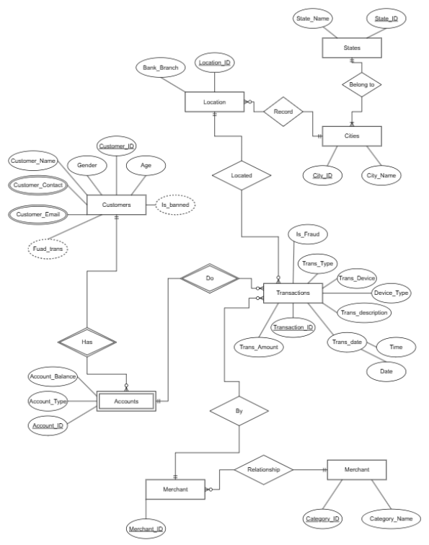
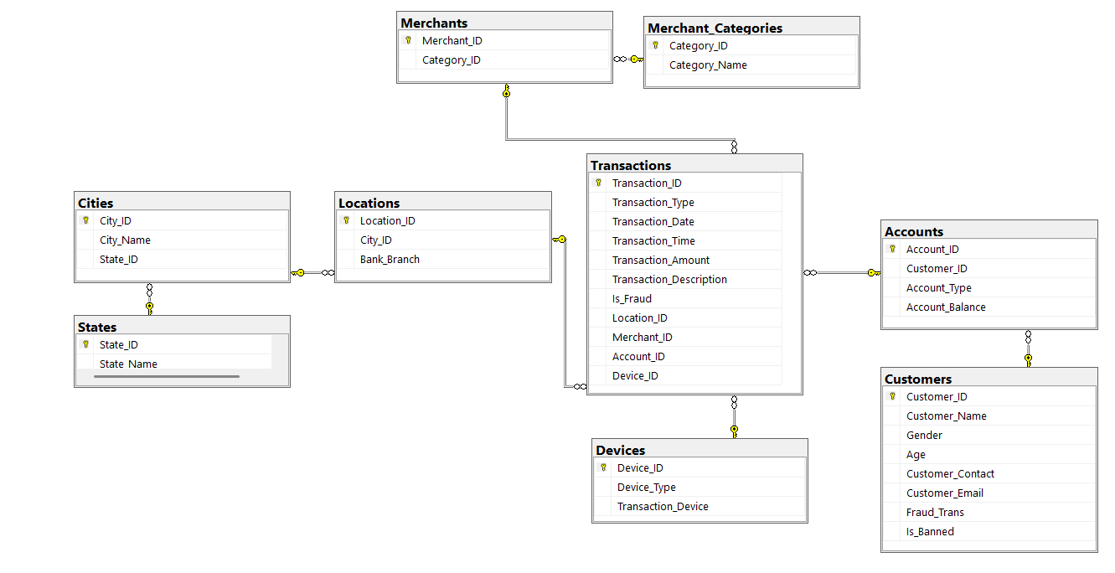
MILESTONES
2
8
DATABASE DESIGN
AMAN
1
DATA COLLECTION
Developed a user-friendly web interface
Collected and cleaned data from multiple sources.
In this phase, we designed the database schema to organize the cleaned data efficiently.
- We created an Entity Relationship Diagram (ERD) to
define relationships between tables such as
customers, transactions, and accounts.
- The database was implemented using SQL Server
Management Studio (SSMS) to ensure structured
and reliable data storage.
- Tools:-
- Drawio (Design ERD, Mapping)
- SSMS (Create Database)
- This design helped ensure data integrity and
supported the data warehouse development.
MAPPING
7
CLOUD
Deployed the system on Azure to ensure scalability, reliability
3
Entity Relationship Diagram
(ERD)
6
DATA WAREHOUSE
MACHINE LEARNING
Built a centralized warehouse for analytical purposes.
Developed a model to detect fraudulent transactions.
4
5
DATA ORCHESTRATION
SCHEMA
DATA ANALYSIS
Automated ETL pipelines using Apache Airflow.
Visualized insights and results through interactive dashboards.

Slide 21
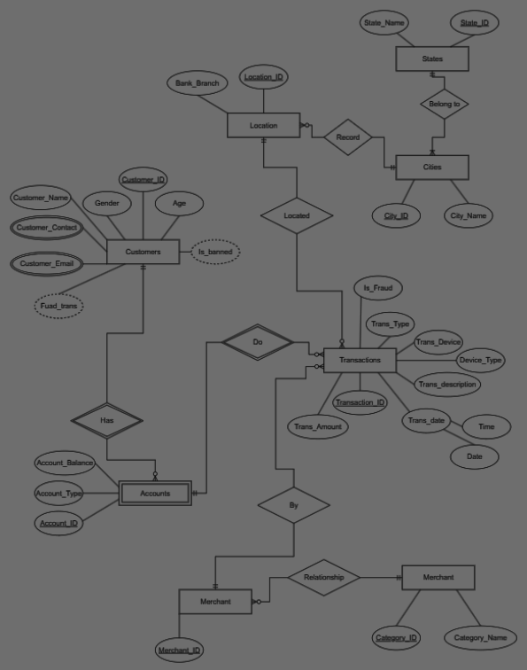
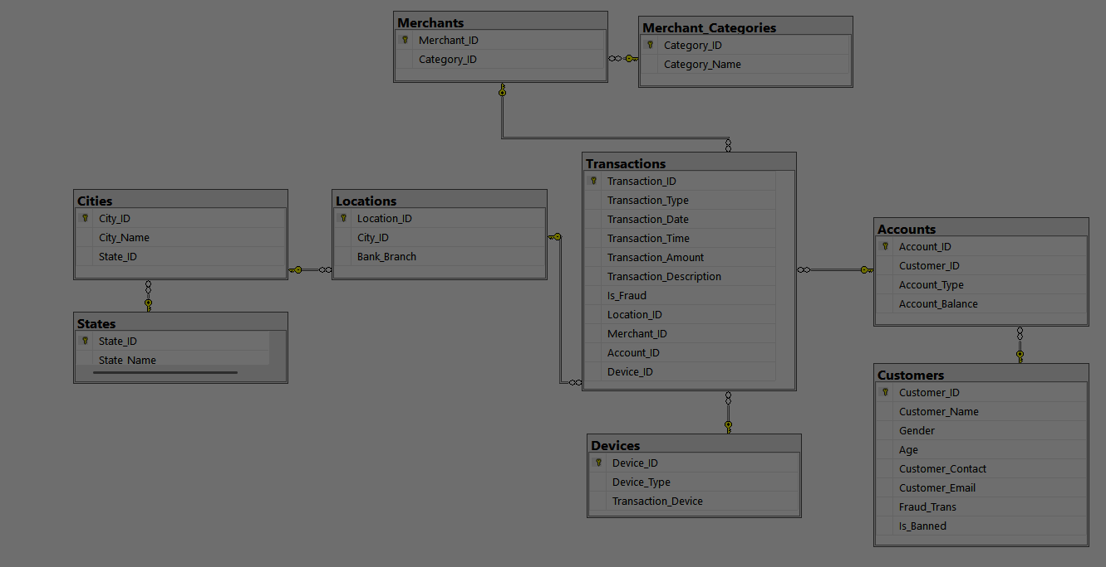
MILESTONES
2
8
DATABASE DESIGN
AMAN
1
Developed a user-friendly web interface
DATA COLLECTION
MAPPING
Collected and cleaned data from multiple sources.
In this phase, we designed the database schema to organize the cleaned data efficiently.
- We created an Entity Relationship Diagram (ERD) to
define relationships between tables such as
customers, transactions, and accounts.
- The database was implemented using SQL Server
Management Studio (SSMS) to ensure structured
and reliable data storage.
- Tools:-
- Drawio (Design ERD, Mapping)
- SSMS (Create Database)
- This design helped ensure data integrity and
supported the data warehouse development.
7
CLOUD
Deployed the system on Azure to ensure scalability, reliability
3
6
DATA WAREHOUSE
MACHINE LEARNING
Built a centralized warehouse for analytical purposes.
Developed a model to detect fraudulent transactions.
4
5
DATA ORCHESTRATION
DATA ANALYSIS
Automated ETL pipelines using Apache Airflow.
Visualized insights and results through interactive dashboards.

Slide 22
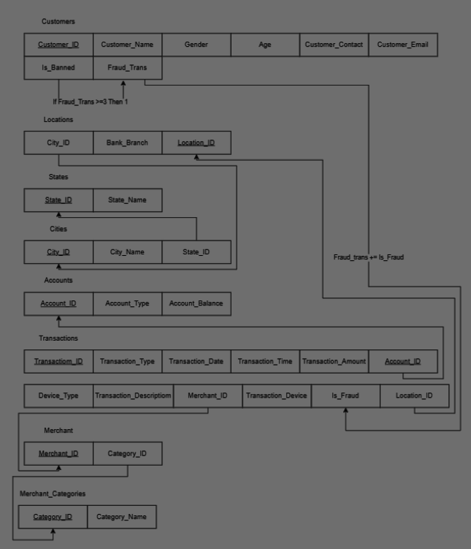
MILESTONES
2
8
DATABASE DESIGN
AMAN
1
Developed a user-friendly web interface
DATA COLLECTION
Collected and cleaned data from multiple sources.
In this phase, we designed the database schema to organize the cleaned data efficiently.
- We created an Entity Relationship Diagram (ERD) to
define relationships between tables such as
customers, transactions, and accounts.
- The database was implemented using SQL Server
Management Studio (SSMS) to ensure structured
and reliable data storage.
- Tools:-
- Drawio (Design ERD, Mapping)
- SSMS (Create Database)
- This design helped ensure data integrity and
supported the data warehouse development.
7
CLOUD
Entity
Relationship
Diagram
(ERD)
Deployed the system on Azure to ensure scalability, reliability
3
6
DATA WAREHOUSE
MACHINE LEARNING
Built a centralized warehouse for analytical purposes.
Developed a model to detect fraudulent transactions.
4
5
DATA ORCHESTRATION
DATA ANALYSIS
Automated ETL pipelines using Apache Airflow.
Visualized insights and results through interactive dashboards.

Slide 23
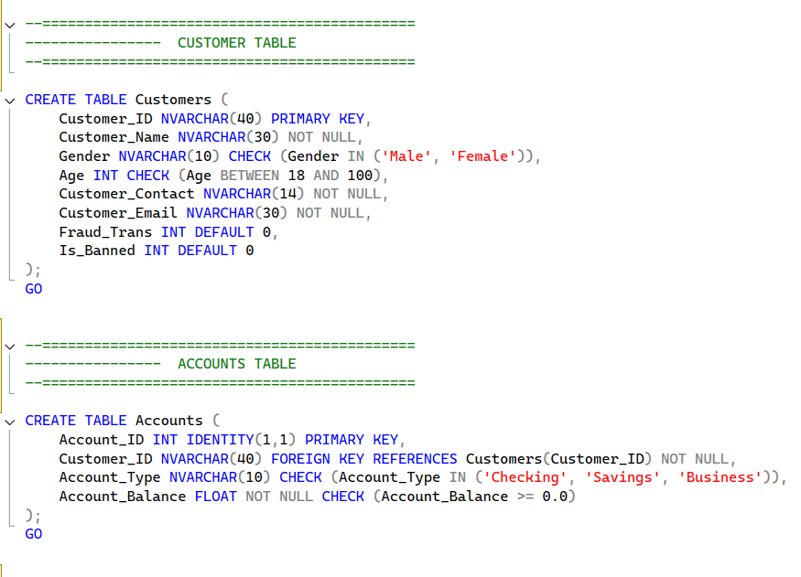

MILESTONES
2
8
DATABASE DESIGN
AMAN
1
Developed a user-friendly web interface
DATA COLLECTION
Collected and cleaned data from multiple sources.
In this phase, we designed the database schema to organize the cleaned data efficiently.
- We created an Entity Relationship Diagram (ERD) to
define relationships between tables such as
customers, transactions, and accounts.
- The database was implemented using SQL Server
Management Studio (SSMS) to ensure structured
and reliable data storage.
- Tools:-
- Drawio (Design ERD, Mapping)
- SSMS (Create Database)
- This design helped ensure data integrity and
supported the data warehouse development.
7
CLOUD
Deployed the system on Azure to ensure scalability, reliability
3
6
SCHEMA
DATA WAREHOUSE
MACHINE LEARNING
Built a centralized warehouse for analytical purposes.
Developed a model to detect fraudulent transactions.
4
SCHEMA
5
DATA ORCHESTRATION
DATA ANALYSIS
Automated ETL pipelines using Apache Airflow.
Visualized insights and results through interactive dashboards.

Slide 24
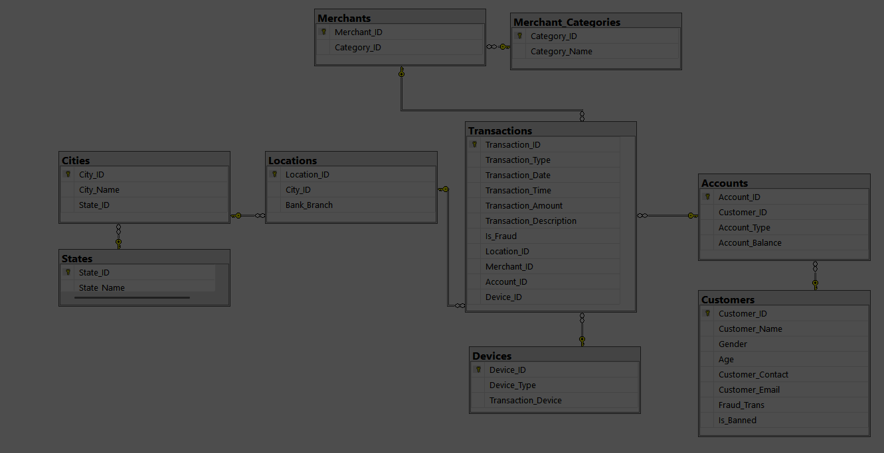
MILESTONES
2
8
DATABASE DESIGN
AMAN
1
Developed a user-friendly web interface
DATA COLLECTION
Collected and cleaned data from multiple sources.
In this phase, we designed the database schema to organize the cleaned data efficiently.
- We created an Entity Relationship Diagram (ERD) to
define relationships between tables such as
customers, transactions, and accounts.
- The database was implemented using SQL Server
Management Studio (SSMS) to ensure structured
and reliable data storage.
- Tools:-
- Drawio (Design ERD, Mapping)
- SSMS (Create Database)
- This design helped ensure data integrity and
supported the data warehouse development.
7
CLOUD
Deployed the system on Azure to ensure scalability, reliability
3
6
DATA WAREHOUSE
MACHINE LEARNING
Built a centralized warehouse for analytical purposes.
Developed a model to detect fraudulent transactions.
4
5
DATA ORCHESTRATION
DATA ANALYSIS
Automated ETL pipelines using Apache Airflow.
Visualized insights and results through interactive dashboards.

Slide 25
MILESTONES
2
8
DATABASE DESIGN
AMAN
1
Developed a user-friendly web interface
DATA COLLECTION
Collected and cleaned data from multiple sources.
In this phase, we designed the database schema to organize the cleaned data efficiently.
- We created an Entity Relationship Diagram (ERD) to
define relationships between tables such as
customers, transactions, and accounts.
- The database was implemented using SQL Server
Management Studio (SSMS) to ensure structured
and reliable data storage.
- Tools:-
- Drawio (Design ERD, Mapping)
- SSMS (Create Database)
- This design helped ensure data integrity and
supported the data warehouse development.
MAPPING
7
CLOUD
Deployed the system on Azure to ensure scalability, reliability
3
Entity Relationship Diagram
(ERD)
6
DATA WAREHOUSE
MACHINE LEARNING
Built a centralized warehouse for analytical purposes.
Developed a model to detect fraudulent transactions.
4
5
DATA ORCHESTRATION
SCHEMA
DATA ANALYSIS
Automated ETL pipelines using Apache Airflow.
Visualized insights and results through interactive dashboards.

Slide 26
MILESTONES
8
AMAN
1
Developed a user-friendly web interface
DATA COLLECTION
Collected and cleaned data from multiple sources.
7
2
CLOUD
DATABASE DESIGN
Deployed the system on Azure to ensure scalability, reliability
Designed schema and created ERD for structured storage.
3
6
DATA WAREHOUSE
MACHINE LEARNING
Built a centralized warehouse for analytical purposes.
Developed a model to detect fraudulent transactions.
4
5
DATA ORCHESTRATION
DATA ANALYSIS
Automated ETL pipelines using Apache Airflow.
Visualized insights and results through interactive dashboards.

Slide 27
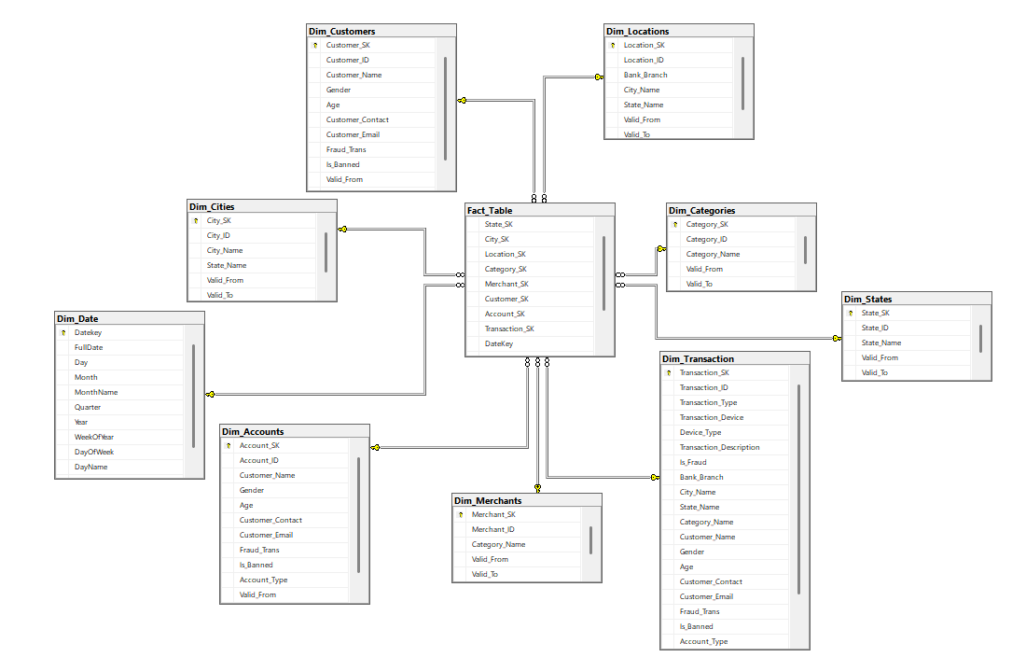
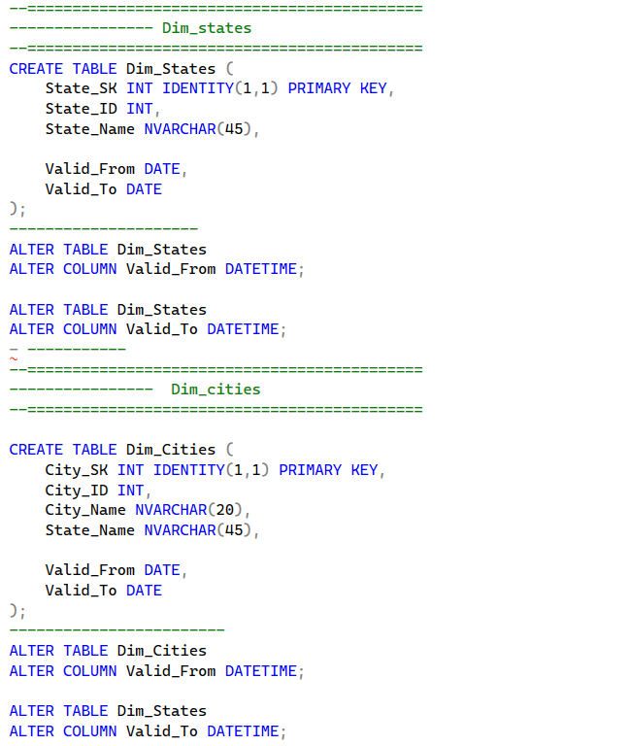
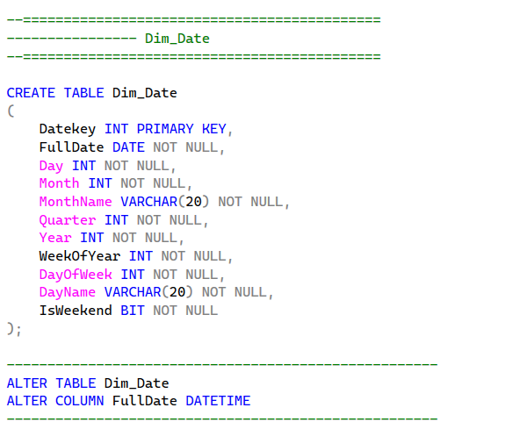
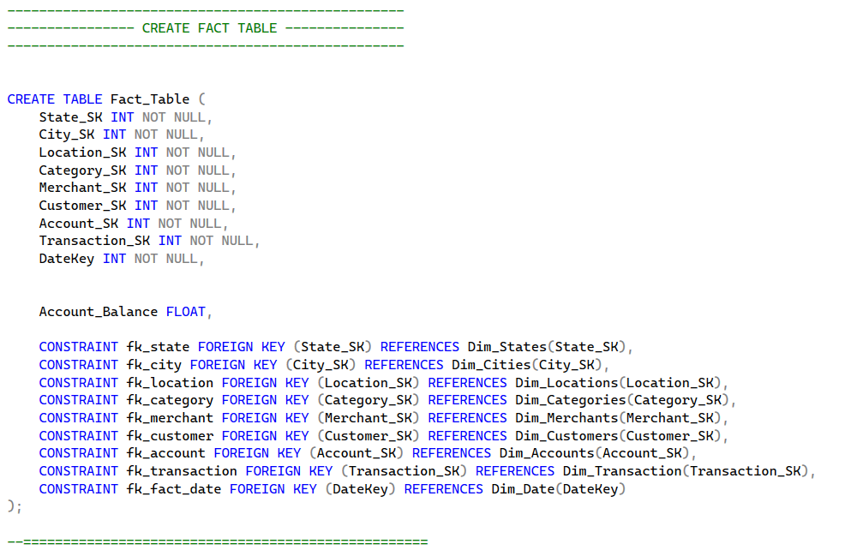
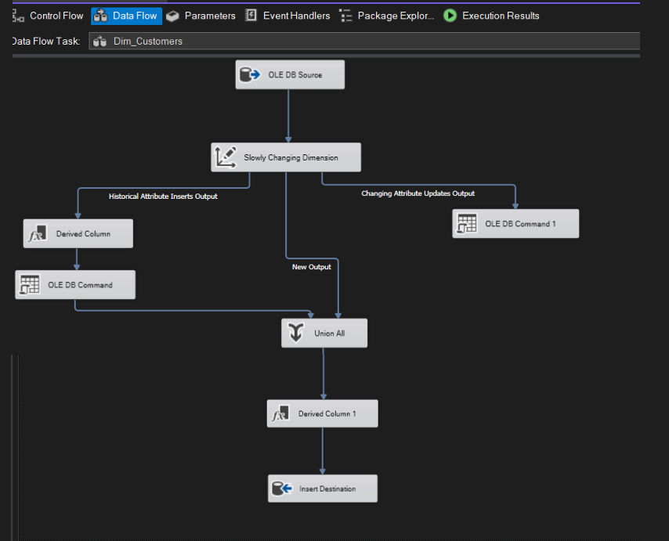
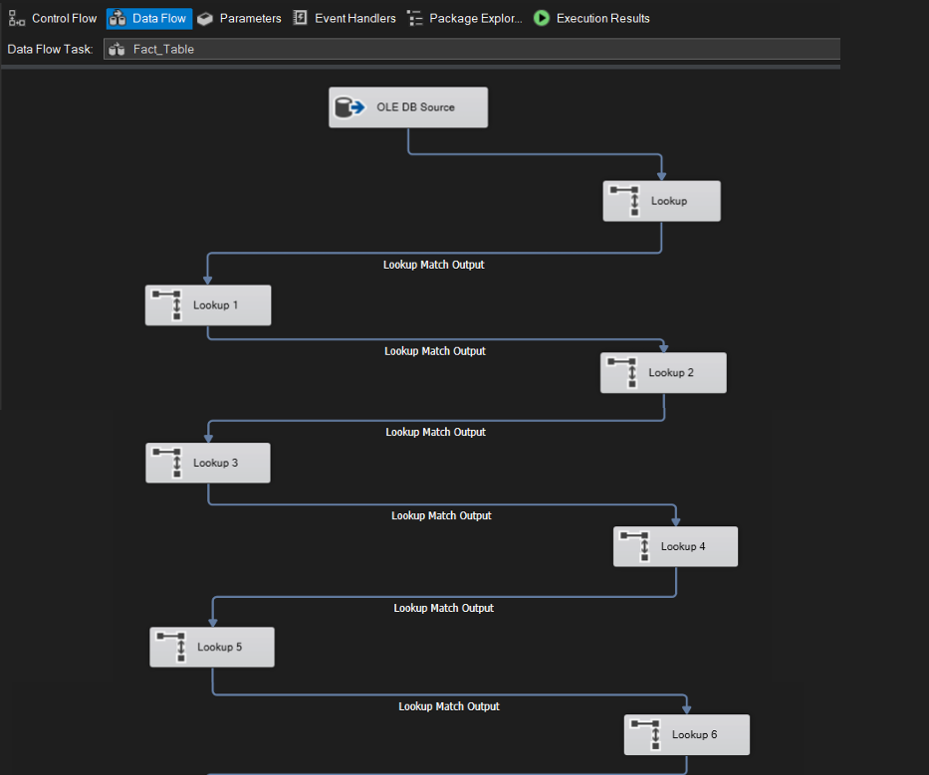
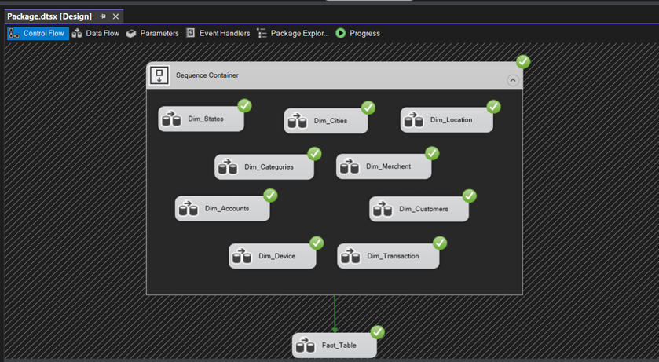
MILESTONES
3
8
DATA WAREHOUSE
AMAN
1
Developed a user-friendly web interface
DATA COLLECTION
Collected and cleaned data from multiple sources.
In this phase, we built a centralized data warehouse to integrate data from multiple sources.
- The warehouse structure was designed using star
schema to optimize data analysis and reporting.
- Tools:-
SSIS
We used SSIS to extract, transform, and load (ETL) data into the warehouse for analytical processing.
7
2
CLOUD
DATABASE DESIGN
Deployed the system on Azure to ensure scalability, reliability
Designed schema and created ERD for structured storage.
6
MACHINE LEARNING
Developed a model to detect fraudulent transactions.
4
5
DATA ORCHESTRATION
DATA ANALYSIS
Automated ETL pipelines using Apache Airflow.
Visualized insights and results through interactive dashboards.

Slide 28
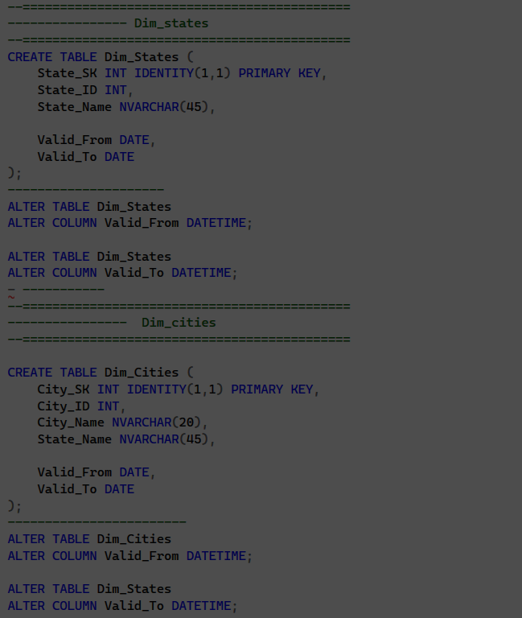
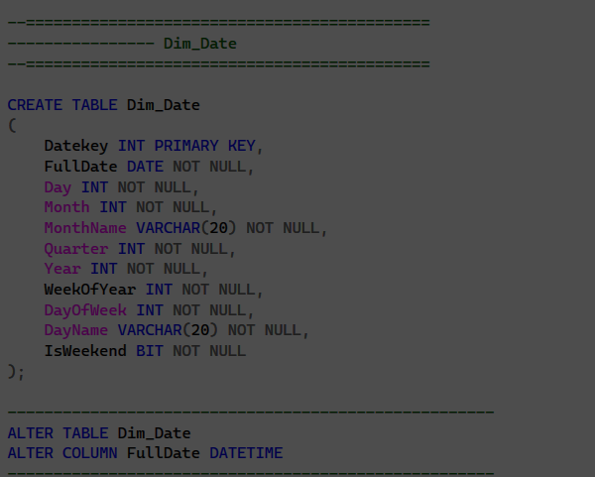
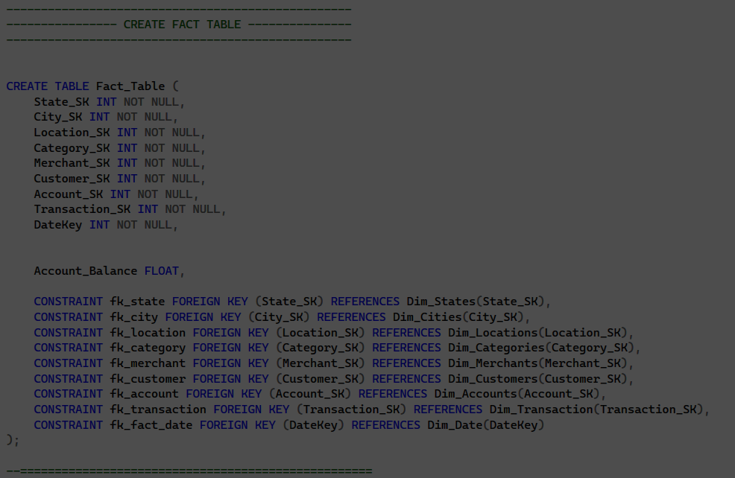
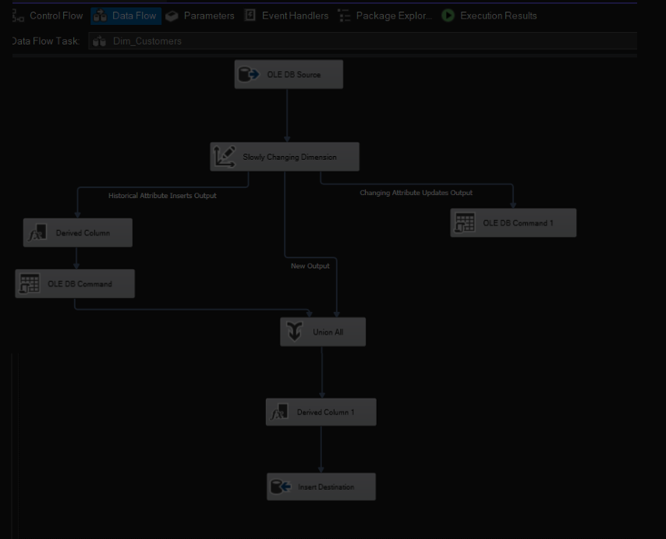
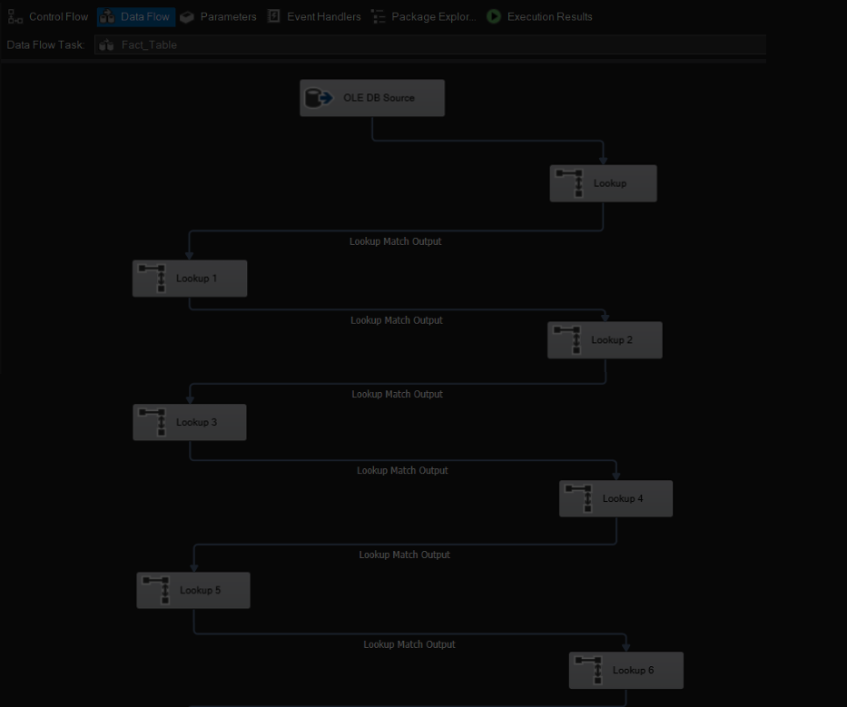
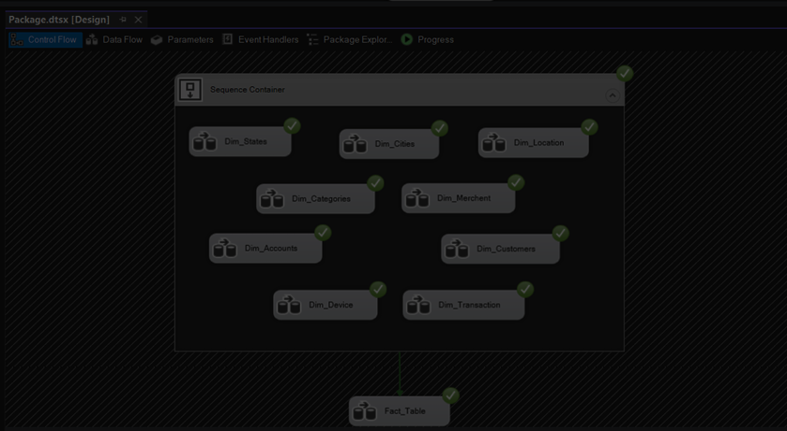
MILESTONES
3
8
DATA WAREHOUSE
STAR
SCHEMA
AMAN
Developed a user-friendly web interface
In this phase, we built a centralized data warehouse to integrate data from multiple sources.
- The warehouse structure was designed using star
schema to optimize data analysis and reporting.
- Tools:-
SSIS
We used SSIS to extract, transform, and load (ETL) data into the warehouse for analytical processing.
2
7
DATABASE DESIGN
CLOUD
Designed schema and created ERD for structured storage.
Deployed the system on Azure to ensure scalability, reliability
3
6
DATA WAREHOUSE
MACHINE LEARNING
Built a centralized warehouse for analytical purposes.
Developed a model to detect fraudulent transactions.
5
DATA ANALYSIS
Visualized insights and results through interactive dashboards.

Slide 29
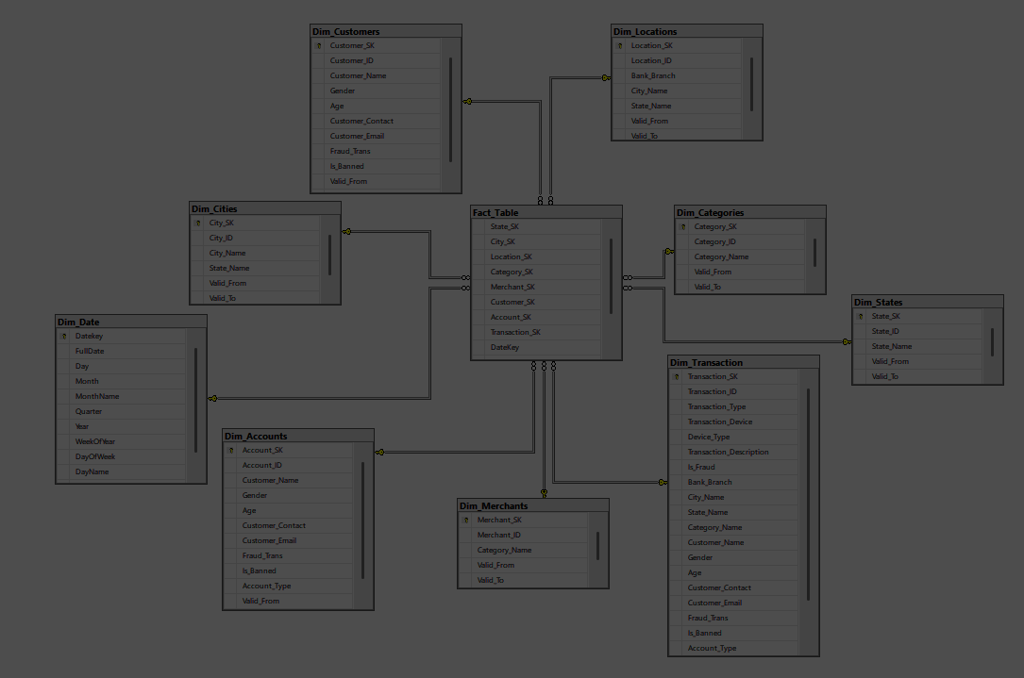
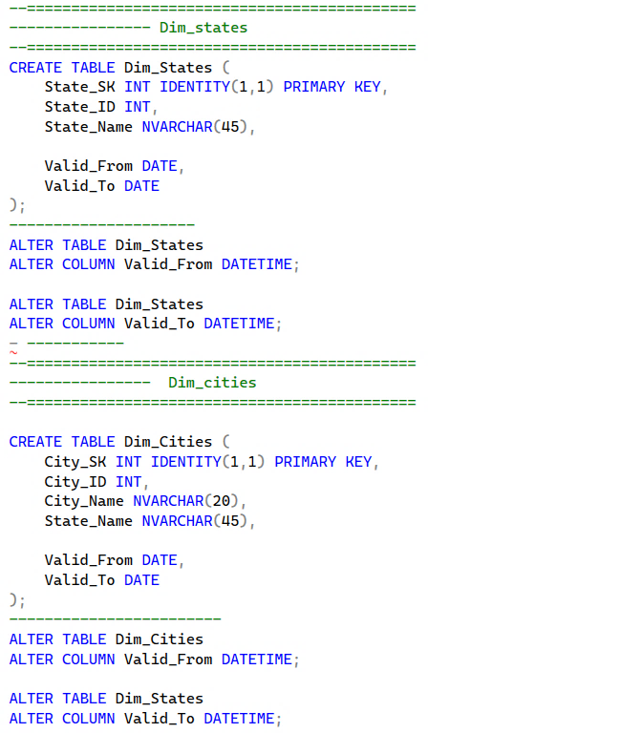
MILESTONES
3
8
DATA WAREHOUSE
AMAN
Developed a user-friendly web interface
DIMENTIONAL TABLES
In this phase, we built a centralized data warehouse to integrate data from multiple sources.
- The warehouse structure was designed using star
schema to optimize data analysis and reporting.
- Tools:-
SSIS
We used SSIS to extract, transform, and load (ETL) data into the warehouse for analytical processing.
2
7
DATABASE DESIGN
CLOUD
Designed schema and created ERD for structured storage.
Deployed the system on Azure to ensure scalability, reliability
3
6
DATA WAREHOUSE
MACHINE LEARNING
Built a centralized warehouse for analytical purposes.
Developed a model to detect fraudulent transactions.
5
DATA ANALYSIS
Visualized insights and results through interactive dashboards.

Slide 30


MILESTONES
3
8
DATA WAREHOUSE
AMAN
Developed a user-friendly web interface
In this phase, we built a centralized data warehouse to integrate data from multiple sources.
- The warehouse structure was designed using star
schema to optimize data analysis and reporting.
- Tools:-
SSIS
We used SSIS to extract, transform, and load (ETL) data into the warehouse for analytical processing.
2
DIMANTIONAL DATE
TABLE
7
DATABASE DESIGN
CLOUD
Designed schema and created ERD for structured storage.
Deployed the system on Azure to ensure scalability, reliability
3
6
DATA WAREHOUSE
MACHINE LEARNING
Built a centralized warehouse for analytical purposes.
Developed a model to detect fraudulent transactions.
5
DATA ANALYSIS
Visualized insights and results through interactive dashboards.

Slide 31


MILESTONES
3
8
DATA WAREHOUSE
AMAN
Developed a user-friendly web interface
In this phase, we built a centralized data warehouse to integrate data from multiple sources.
- The warehouse structure was designed using star
schema to optimize data analysis and reporting.
- Tools:-
SSIS
We used SSIS to extract, transform, and load (ETL) data into the warehouse for analytical processing.
2
7
DATABASE DESIGN
CLOUD
Designed schema and created ERD for structured storage.
Deployed the system on Azure to ensure scalability, reliability
FACT TABLE
3
6
DATA WAREHOUSE
MACHINE LEARNING
Built a centralized warehouse for analytical purposes.
Developed a model to detect fraudulent transactions.
5
DATA ANALYSIS
Visualized insights and results through interactive dashboards.

Slide 32
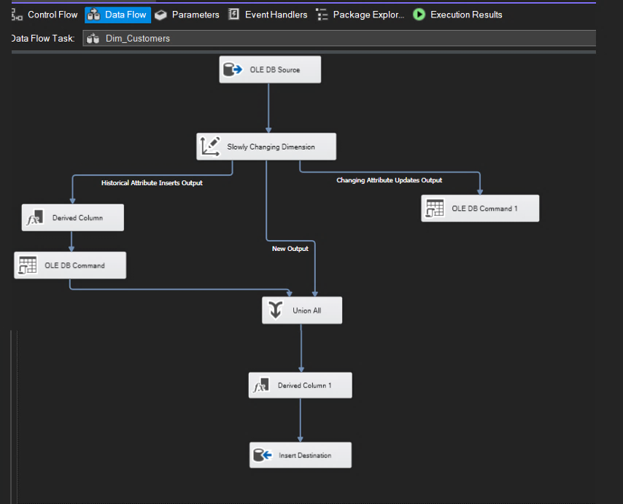
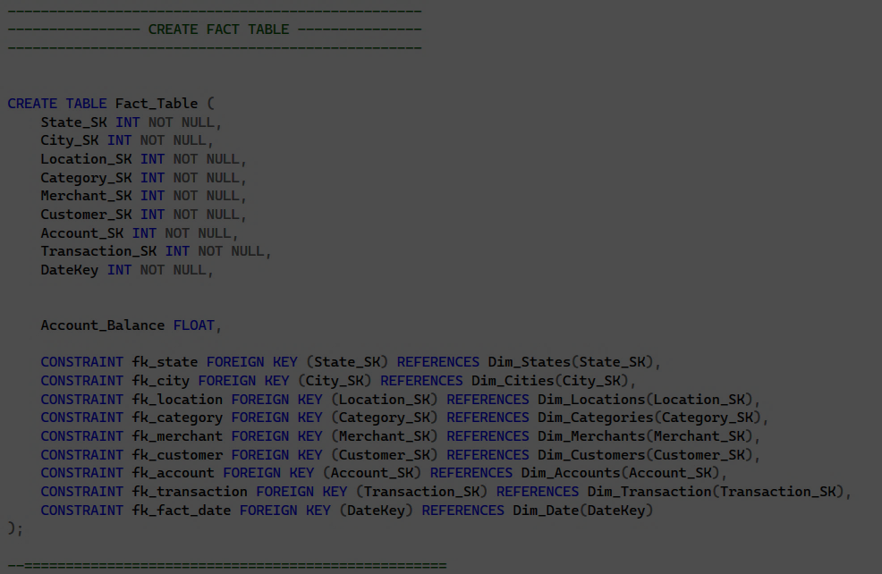
MILESTONES
3
8
DATA WAREHOUSE
AMAN
Developed a user-friendly web interface
In this phase, we built a centralized data warehouse to integrate data from multiple sources.
- The warehouse structure was designed using star
schema to optimize data analysis and reporting.
- Tools:-
SSIS
We used SSIS to extract, transform, and load (ETL) data into the warehouse for analytical processing.
2
7
DATABASE DESIGN
CLOUD
Designed schema and created ERD for structured storage.
Deployed the system on Azure to ensure scalability, reliability
3
6
DATA WAREHOUSE
SSIS
MACHINE LEARNING
Built a centralized warehouse for analytical purposes.
Developed a model to detect fraudulent transactions.
5
DATA ANALYSIS
Visualized insights and results through interactive dashboards.

Slide 33
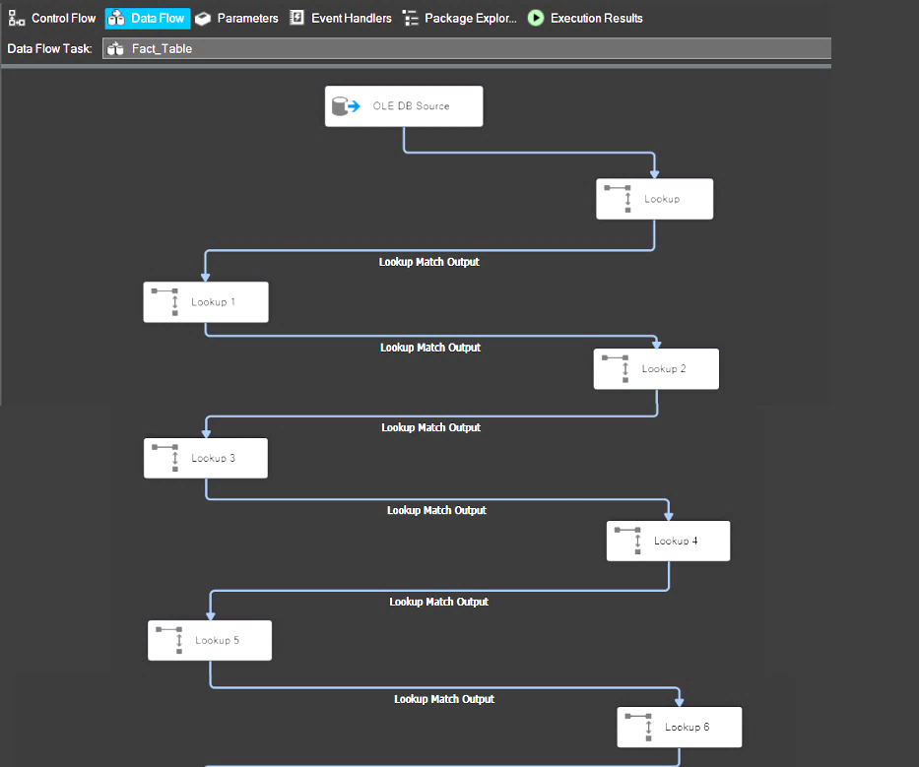
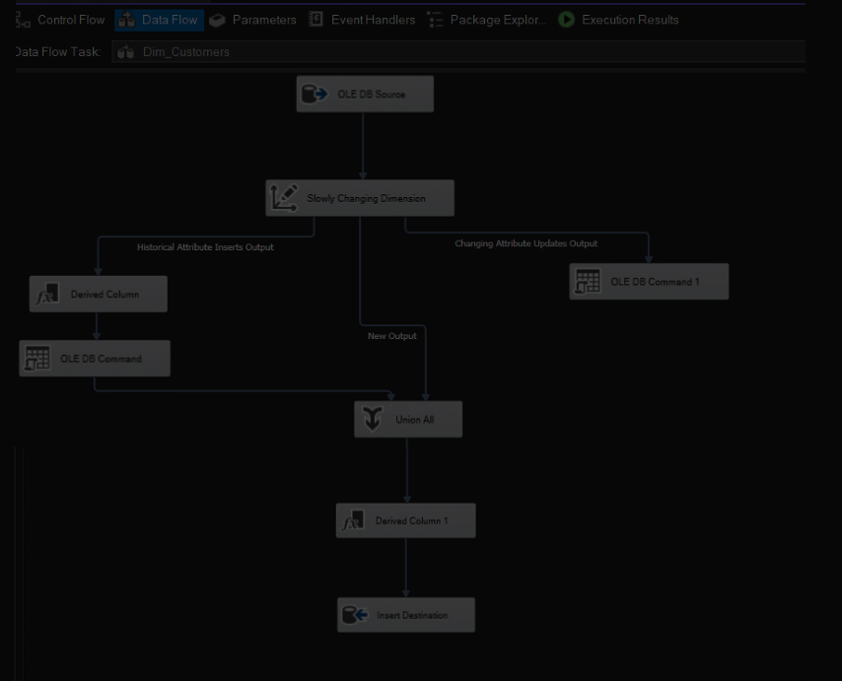
MILESTONES
3
8
DATA WAREHOUSE
AMAN
Developed a user-friendly web interface
In this phase, we built a centralized data warehouse to integrate data from multiple sources.
- The warehouse structure was designed using star
schema to optimize data analysis and reporting.
- Tools:-
SSIS
We used SSIS to extract, transform, and load (ETL) data into the warehouse for analytical processing.
2
7
DATABASE DESIGN
CLOUD
Designed schema and created ERD for structured storage.
Deployed the system on Azure to ensure scalability, reliability
3
6
DATA WAREHOUSE
MACHINE LEARNING
Built a centralized warehouse for analytical purposes.
Developed a model to detect fraudulent transactions.
SSIS
5
DATA ANALYSIS
Visualized insights and results through interactive dashboards.

Slide 34
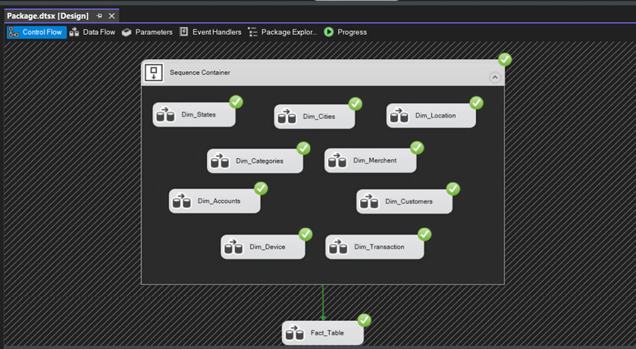

MILESTONES
3
8
DATA WAREHOUSE
AMAN
Developed a user-friendly web interface
In this phase, we built a centralized data warehouse to integrate data from multiple sources.
- The warehouse structure was designed using star
schema to optimize data analysis and reporting.
- Tools:-
SSIS
We used SSIS to extract, transform, and load (ETL) data into the warehouse for analytical processing.
2
7
DATABASE DESIGN
CLOUD
Designed schema and created ERD for structured storage.
Deployed the system on Azure to ensure scalability, reliability
3
6
DATA WAREHOUSE
MACHINE LEARNING
Built a centralized warehouse for analytical purposes.
Developed a model to detect fraudulent transactions.
5
DATA ANALYSIS
SSIS
Visualized insights and results through interactive dashboards.

Slide 35
MILESTONES
3
8
DATA WAREHOUSE
AMAN
1
Developed a user-friendly web interface
DATA COLLECTION
Collected and cleaned data from multiple sources.
In this phase, we built a centralized data warehouse to integrate data from multiple sources.
- The warehouse structure was designed using star
schema to optimize data analysis and reporting.
- Tools:-
SSIS
We used SSIS to extract, transform, and load (ETL) data into the warehouse for analytical processing.
7
2
CLOUD
DATABASE DESIGN
Deployed the system on Azure to ensure scalability, reliability
Designed schema and created ERD for structured storage.
6
MACHINE LEARNING
Developed a model to detect fraudulent transactions.
4
5
DATA ORCHESTRATION
DATA ANALYSIS
Automated ETL pipelines using Apache Airflow.
Visualized insights and results through interactive dashboards.

Slide 36
MILESTONES
8
AMAN
1
Developed a user-friendly web interface
DATA COLLECTION
Collected and cleaned data from multiple sources.
7
2
CLOUD
DATABASE DESIGN
Deployed the system on Azure to ensure scalability, reliability
Designed schema and created ERD for structured storage.
3
6
DATA WAREHOUSE
MACHINE LEARNING
Built a centralized warehouse for analytical purposes.
Developed a model to detect fraudulent transactions.
4
5
DATA ORCHESTRATION
DATA ANALYSIS
Automated ETL pipelines using Apache Airflow.
Visualized insights and results through interactive dashboards.

Slide 37
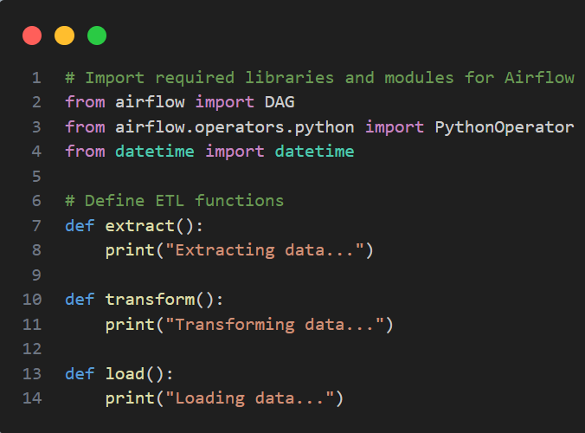
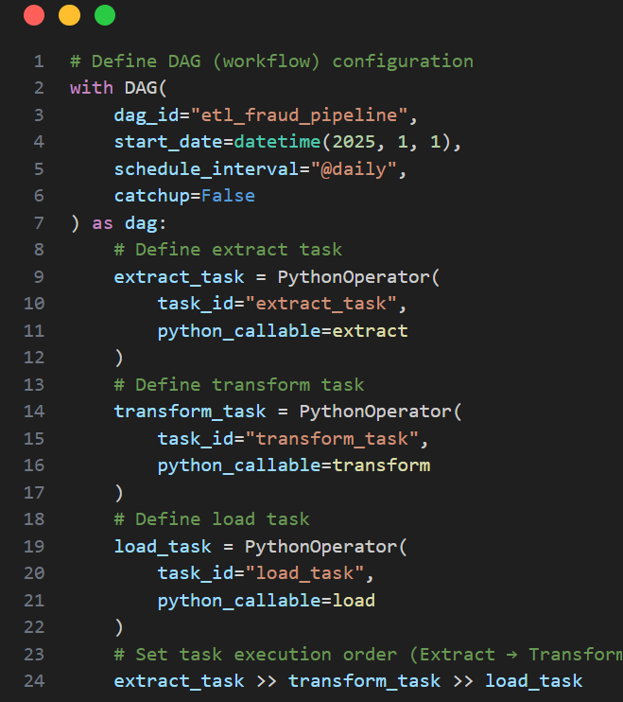
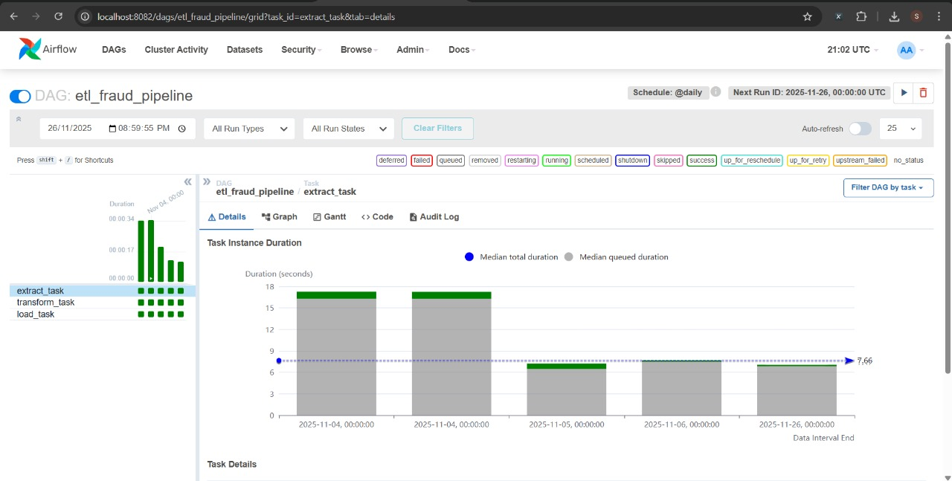
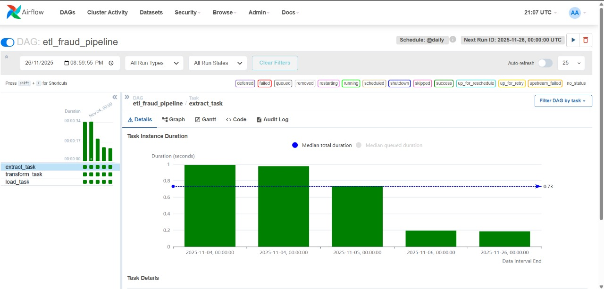
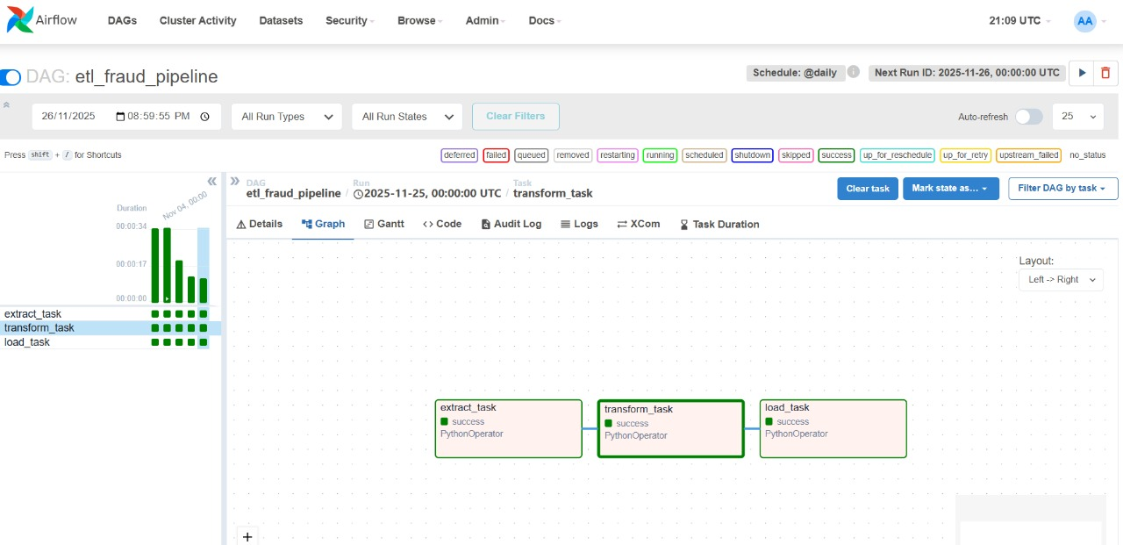
MILESTONES
4
8
DATA ORCHESTRATION
AMAN
Developed a user-friendly web interface
In this phase, we automated the flow of data, so the system runs on its own.
- The pipeline runs every hour and performs three
main steps:
1- Get new data from the mock data generator.
2- Send the data to the ML model to predict whether
the transaction is safe or fraud.
3- Store the results automatically in the database.
- Tools:-
Airflow
This milestone ensures that the system stays updated and works smoothly without manual intervention.
2
7
DATABASE DESIGN
CLOUD
Designed schema and created ERD for structured storage.
Deployed the system on Azure to ensure scalability, reliability
3
6
DATA WAREHOUSE
MACHINE LEARNING
Built a centralized warehouse for analytical purposes.
Developed a model to detect fraudulent transactions.
5
DATA ANALYSIS
Visualized insights and results through interactive dashboards.

Slide 38
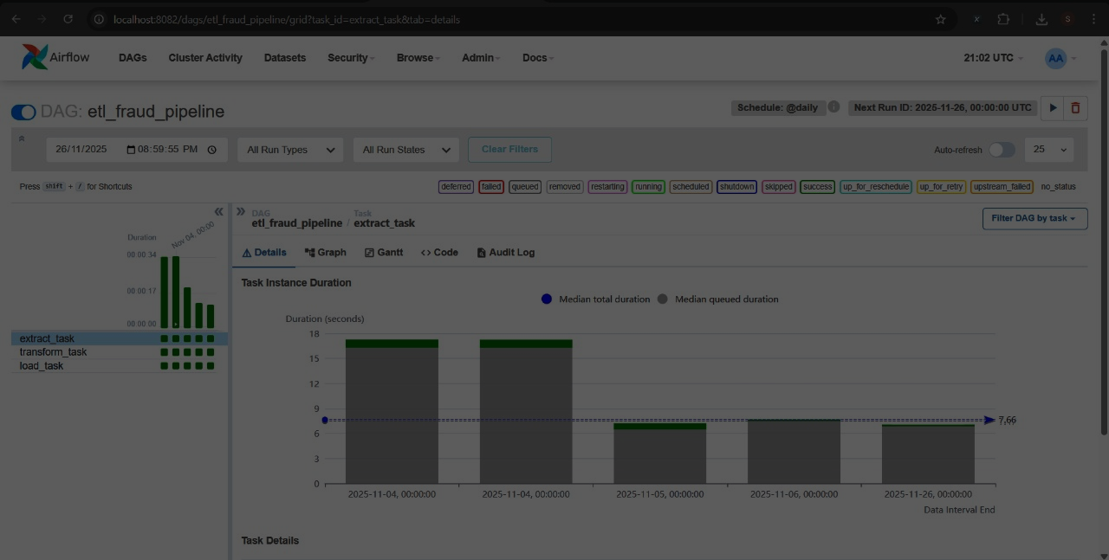
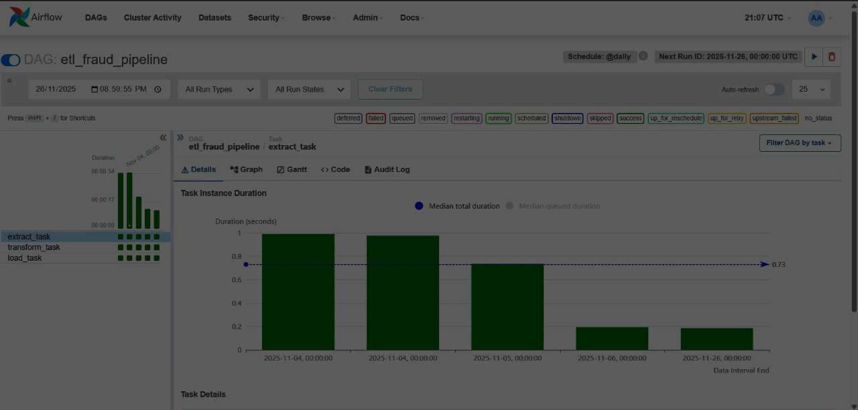
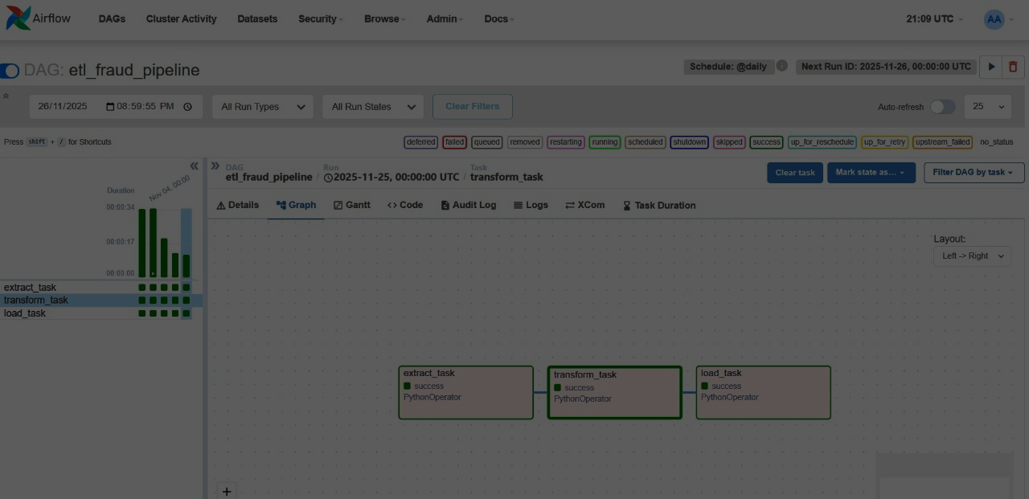
MILESTONES
4
DATA ORCHESTRATION
8
AMAN
Developed a user-friendly web interface
In this phase, we automated the flow of data, so the system runs on its own.
- The pipeline runs every hour and performs three
main steps:
1- Get new data from the mock data generator.
2- Send the data to the ML model to predict whether
the transaction is safe or fraud.
3- Store the results automatically in the database.
- Tools:-
Airflow
This milestone ensures that the system stays updated and works smoothly without manual intervention.
2
7
DATABASE DESIGN
CLOUD
Designed schema and created ERD for structured storage.
Deployed the system on Azure to ensure scalability, reliability
3
6
DATA WAREHOUSE
MACHINE LEARNING
Built a centralized warehouse for analytical purposes.
Developed a model to detect fraudulent transactions.
5
DATA ANALYSIS
Visualized insights and results through interactive dashboards.

Slide 39
MILESTONES
4
DATA ORCHESTRATION
8
AMAN
Developed a user-friendly web interface
In this phase, we automated the flow of data, so the system runs on its own.
- The pipeline runs every hour and performs three
main steps:
1- Get new data from the mock data generator.
2- Send the data to the ML model to predict whether
the transaction is safe or fraud.
3- Store the results automatically in the database.
- Tools:-
Airflow
This milestone ensures that the system stays updated and works smoothly without manual intervention.
2
7
DATABASE DESIGN
CLOUD
Designed schema and created ERD for structured storage.
Deployed the system on Azure to ensure scalability, reliability
3
6
DATA WAREHOUSE
MACHINE LEARNING
Built a centralized warehouse for analytical purposes.
Developed a model to detect fraudulent transactions.
5
DATA ANALYSIS
Visualized insights and results through interactive dashboards.

Slide 40

MILESTONES
4
DATA ORCHESTRATION
8
AMAN
Developed a user-friendly web interface
In this phase, we automated the flow of data, so the system runs on its own.
- The pipeline runs every hour and performs three
main steps:
1- Get new data from the mock data generator.
2- Send the data to the ML model to predict whether
the transaction is safe or fraud.
3- Store the results automatically in the database.
- Tools:-
Airflow
This milestone ensures that the system stays updated and works smoothly without manual intervention.
2
7
DATABASE DESIGN
CLOUD
Designed schema and created ERD for structured storage.
Deployed the system on Azure to ensure scalability, reliability
3
6
DATA WAREHOUSE
MACHINE LEARNING
Built a centralized warehouse for analytical purposes.
Developed a model to detect fraudulent transactions.
5
DATA ANALYSIS
Visualized insights and results through interactive dashboards.

Slide 41


MILESTONES
4
DATA ORCHESTRATION
8
AMAN
Developed a user-friendly web interface
In this phase, we automated the flow of data, so the system runs on its own.
- The pipeline runs every hour and performs three
main steps:
1- Get new data from the mock data generator.
2- Send the data to the ML model to predict whether
the transaction is safe or fraud.
3- Store the results automatically in the database.
- Tools:-
Airflow
This milestone ensures that the system stays updated and works smoothly without manual intervention.
2
7
DATABASE DESIGN
CLOUD
Designed schema and created ERD for structured storage.
Deployed the system on Azure to ensure scalability, reliability
3
6
DATA WAREHOUSE
MACHINE LEARNING
Built a centralized warehouse for analytical purposes.
Developed a model to detect fraudulent transactions.
5
DATA ANALYSIS
Visualized insights and results through interactive dashboards.

Slide 42


MILESTONES
4
DATA ORCHESTRATION
8
AMAN
Developed a user-friendly web interface
In this phase, we automated the flow of data, so the system runs on its own.
- The pipeline runs every hour and performs three
main steps:
1- Get new data from the mock data generator.
2- Send the data to the ML model to predict whether
the transaction is safe or fraud.
3- Store the results automatically in the database.
- Tools:-
Airflow
This milestone ensures that the system stays updated and works smoothly without manual intervention.
2
7
DATABASE DESIGN
CLOUD
Designed schema and created ERD for structured storage.
Deployed the system on Azure to ensure scalability, reliability
3
6
DATA WAREHOUSE
MACHINE LEARNING
Built a centralized warehouse for analytical purposes.
Developed a model to detect fraudulent transactions.
5
DATA ANALYSIS
Visualized insights and results through interactive dashboards.

Slide 43
MILESTONES
4
8
DATA ORCHESTRATION
AMAN
Developed a user-friendly web interface
In this phase, we automated the flow of data, so the system runs on its own.
- The pipeline runs every hour and performs three
main steps:
1- Get new data from the mock data generator.
2- Send the data to the ML model to predict whether
the transaction is safe or fraud.
3- Store the results automatically in the database.
- Tools:-
Airflow
This milestone ensures that the system stays updated and works smoothly without manual intervention.
2
7
DATABASE DESIGN
CLOUD
Designed schema and created ERD for structured storage.
Deployed the system on Azure to ensure scalability, reliability
3
6
DATA WAREHOUSE
MACHINE LEARNING
Built a centralized warehouse for analytical purposes.
Developed a model to detect fraudulent transactions.
5
DATA ANALYSIS
Visualized insights and results through interactive dashboards.

Slide 44
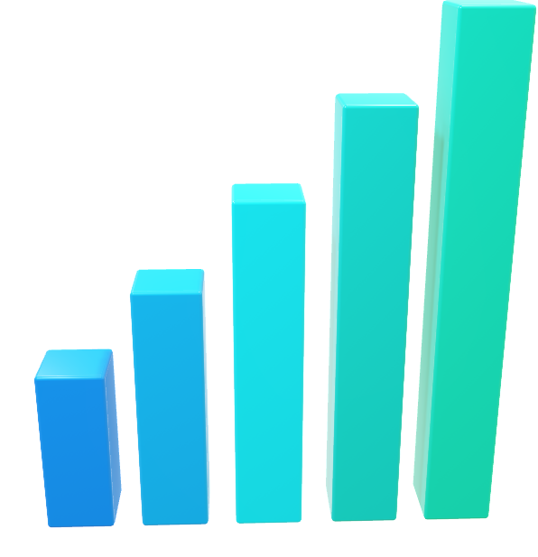
MILESTONES
8
AMAN
1
Developed a user-friendly web interface
DATA COLLECTION
Collected and cleaned data from multiple sources.
7
2
CLOUD
DATABASE DESIGN
Deployed the system on Azure to ensure scalability, reliability
Designed schema and created ERD for structured storage.
3
6
DATA WAREHOUSE
MACHINE LEARNING
Built a centralized warehouse for analytical purposes.
Developed a model to detect fraudulent transactions.
4
5
DATA ORCHESTRATION
DATA ANALYSIS
Automated ETL pipelines using Apache Airflow.
Visualized insights and results through interactive dashboards.

Slide 45
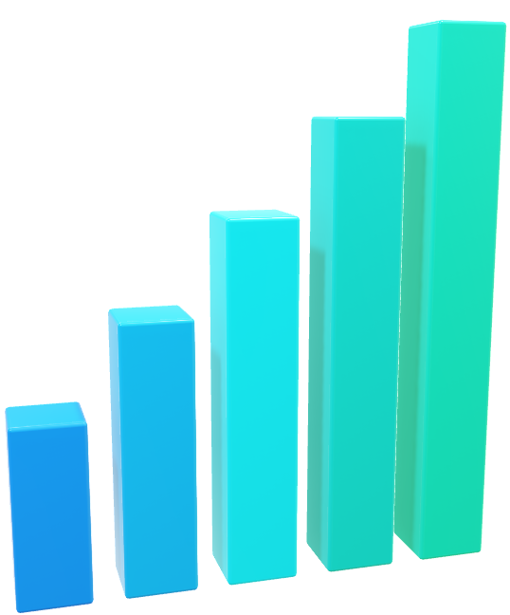
MILESTONES
5
DATA ANALYSIS
8
AMAN
In this phase, we explored, analyzed, and interpreted the
processed data to extract meaningful insights that support
fraud detection.
We performed exploratory data analysis (EDA), identified
patterns and correlations, and detected suspicious
behaviors and trends that can help improve decision-making
and enhance the ML detection model.
- It sends a detailed daily report to the email.
- Tools:-
Power BI
- We used Power BI to visualize the analyzed data, create interactive
dashboards, and highlight fraud-related patterns and insights in a clear
and user-friendly way. The final dashboard consists of three pages:
- Home Overview
- Customer Insights - Fraud Analysis
Developed a user-friendly web interface
2
7
DATABASE DESIGN
CLOUD
Designed schema and created ERD for structured storage.
Deployed the system on Azure to ensure scalability, reliability
3
6
DATA WAREHOUSE
MACHINE LEARNING
Built a centralized warehouse for analytical purposes.
Developed a model to detect fraudulent transactions.
5
DATA ANALYSIS
Click here
Visualized insights and results through interactive dashboards.

Slide 46
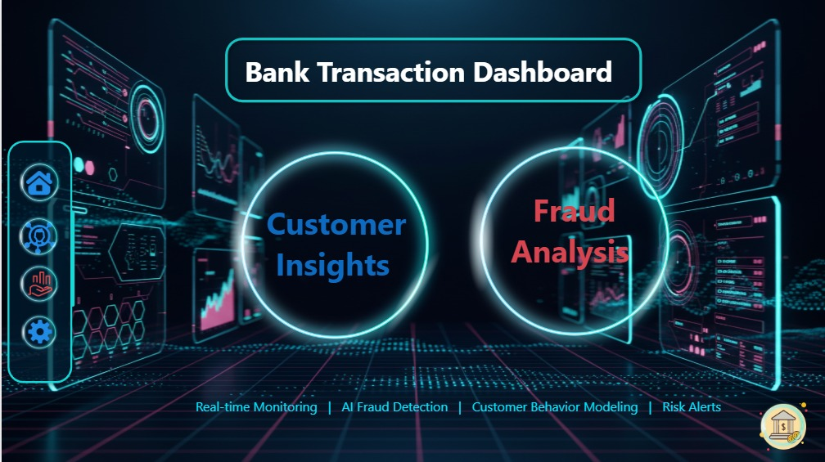





MILESTONES
5
8
DATA ANALYSIS
AMAN
Developed a user-friendly web interface
In this phase, we explored, analyzed, and interpreted the
processed data to extract meaningful insights that support
fraud detection.
We performed exploratory data analysis (EDA), identified
patterns and correlations, and detected suspicious
behaviors and trends that can help improve decision-making
and enhance the ML detection model.
- Tools:-
Power BI
- We used Power BI to visualize the analyzed data, create interactive
dashboards, and highlight fraud-related patterns and insights in a clear
and user-friendly way. The final dashboard consists of three pages:
- Home Overview
- Customer Insights
- Fraud Analysis
2
7
DATABASE DESIGN
CLOUD
Designed schema and created ERD for structured storage.
Deployed the system on Azure to ensure scalability, reliability
3
6
DATA WAREHOUSE
MACHINE LEARNING
Built a centralized warehouse for analytical purposes.
Developed a model to detect fraudulent transactions.
5
DATA ANALYSIS
Visualized insights and results through interactive dashboards.

Slide 47
MILESTONES
5
8
DATA ANALYSIS
AMAN
Developed a user-friendly web interface
In this phase, we explored, analyzed, and interpreted the
processed data to extract meaningful insights that support
fraud detection.
We performed exploratory data analysis (EDA), identified
patterns and correlations, and detected suspicious
behaviors and trends that can help improve decision-making
and enhance the ML detection model.
- Tools:-
Power BI
- We used Power BI to visualize the analyzed data, create interactive
dashboards, and highlight fraud-related patterns and insights in a clear
and user-friendly way. The final dashboard consists of three pages:
- Home Overview
- Customer Insights
- Fraud Analysis
2
7
DATABASE DESIGN
CLOUD
Designed schema and created ERD for structured storage.
Deployed the system on Azure to ensure scalability, reliability
3
6
DATA WAREHOUSE
MACHINE LEARNING
Built a centralized warehouse for analytical purposes.
Developed a model to detect fraudulent transactions.
5
DATA ANALYSIS
Visualized insights and results through interactive dashboards.

Slide 48
MILESTONES
5
8
DATA ANALYSIS
AMAN
Developed a user-friendly web interface
In this phase, we explored, analyzed, and interpreted the
processed data to extract meaningful insights that support
fraud detection.
We performed exploratory data analysis (EDA), identified
patterns and correlations, and detected suspicious
behaviors and trends that can help improve decision-making
and enhance the ML detection model.
- Tools:-
Power BI
- We used Power BI to visualize the analyzed data, create interactive
dashboards, and highlight fraud-related patterns and insights in a clear
and user-friendly way. The final dashboard consists of three pages:
- Home Overview
- Customer Insights
- Fraud Analysis
2
7
DATABASE DESIGN
CLOUD
Designed schema and created ERD for structured storage.
Deployed the system on Azure to ensure scalability, reliability
3
6
DATA WAREHOUSE
MACHINE LEARNING
Built a centralized warehouse for analytical purposes.
Developed a model to detect fraudulent transactions.
5
DATA ANALYSIS
Visualized insights and results through interactive dashboards.

Slide 49
MILESTONES
5
8
DATA ANALYSIS
AMAN
Developed a user-friendly web interface
In this phase, we explored, analyzed, and interpreted the
processed data to extract meaningful insights that support
fraud detection.
We performed exploratory data analysis (EDA), identified
patterns and correlations, and detected suspicious
behaviors and trends that can help improve decision-making
and enhance the ML detection model.
- Tools:-
Power BI
- We used Power BI to visualize the analyzed data, create interactive
dashboards, and highlight fraud-related patterns and insights in a clear
and user-friendly way. The final dashboard consists of three pages:
- Home Overview
- Customer Insights
- Fraud Analysis
2
7
DATABASE DESIGN
CLOUD
Designed schema and created ERD for structured storage.
Deployed the system on Azure to ensure scalability, reliability
3
6
DATA WAREHOUSE
MACHINE LEARNING
Built a centralized warehouse for analytical purposes.
Developed a model to detect fraudulent transactions.
5
DATA ANALYSIS
Visualized insights and results through interactive dashboards.

Slide 50
MILESTONES
5
8
DATA ANALYSIS
AMAN
Developed a user-friendly web interface
In this phase, we explored, analyzed, and interpreted the
processed data to extract meaningful insights that support
fraud detection.
We performed exploratory data analysis (EDA), identified
patterns and correlations, and detected suspicious
behaviors and trends that can help improve decision-making
and enhance the ML detection model.
- Tools:-
Power BI
- We used Power BI to visualize the analyzed data, create interactive
dashboards, and highlight fraud-related patterns and insights in a clear
and user-friendly way. The final dashboard consists of three pages:
- Home Overview
- Customer Insights
- Fraud Analysis
2
7
DATABASE DESIGN
CLOUD
Designed schema and created ERD for structured storage.
Deployed the system on Azure to ensure scalability, reliability
3
6
DATA WAREHOUSE
MACHINE LEARNING
Built a centralized warehouse for analytical purposes.
Developed a model to detect fraudulent transactions.
5
DATA ANALYSIS
Visualized insights and results through interactive dashboards.

Slide 51
MILESTONES
5
8
DATA ANALYSIS
AMAN
Developed a user-friendly web interface
In this phase, we explored, analyzed, and interpreted the
processed data to extract meaningful insights that support
fraud detection.
We performed exploratory data analysis (EDA), identified
patterns and correlations, and detected suspicious
behaviors and trends that can help improve decision-making
and enhance the ML detection model.
- Tools:-
Power BI
- We used Power BI to visualize the analyzed data, create interactive
dashboards, and highlight fraud-related patterns and insights in a clear
and user-friendly way. The final dashboard consists of three pages:
- Home Overview
- Customer Insights
- Fraud Analysis
2
7
DATABASE DESIGN
CLOUD
Designed schema and created ERD for structured storage.
Deployed the system on Azure to ensure scalability, reliability
3
6
DATA WAREHOUSE
MACHINE LEARNING
Built a centralized warehouse for analytical purposes.
Developed a model to detect fraudulent transactions.
5
DATA ANALYSIS
Visualized insights and results through interactive dashboards.

Slide 52
MILESTONES
5
8
DATA ANALYSIS
AMAN
Developed a user-friendly web interface
In this phase, we explored, analyzed, and interpreted the
processed data to extract meaningful insights that support
fraud detection.
We performed exploratory data analysis (EDA), identified
patterns and correlations, and detected suspicious
behaviors and trends that can help improve decision-making
and enhance the ML detection model.
- Tools:-
Power BI
- We used Power BI to visualize the analyzed data, create interactive
dashboards, and highlight fraud-related patterns and insights in a clear
and user-friendly way. The final dashboard consists of three pages:
- Home Overview
- Customer Insights
- Fraud Analysis
2
7
DATABASE DESIGN
CLOUD
Designed schema and created ERD for structured storage.
Deployed the system on Azure to ensure scalability, reliability
3
6
DATA WAREHOUSE
MACHINE LEARNING
Built a centralized warehouse for analytical purposes.
Developed a model to detect fraudulent transactions.
5
DATA ANALYSIS
Visualized insights and results through interactive dashboards.

Slide 53
MILESTONES
5
8
DATA ANALYSIS
AMAN
Developed a user-friendly web interface
In this phase, we explored, analyzed, and interpreted the
processed data to extract meaningful insights that support
fraud detection.
We performed exploratory data analysis (EDA), identified
patterns and correlations, and detected suspicious
behaviors and trends that can help improve decision-making
and enhance the ML detection model.
- Tools:-
Power BI
- We used Power BI to visualize the analyzed data, create interactive
dashboards, and highlight fraud-related patterns and insights in a clear
and user-friendly way. The final dashboard consists of three pages:
- Home Overview
- Customer Insights
- Fraud Analysis
2
7
DATABASE DESIGN
CLOUD
Designed schema and created ERD for structured storage.
Deployed the system on Azure to ensure scalability, reliability
3
6
DATA WAREHOUSE
MACHINE LEARNING
Built a centralized warehouse for analytical purposes.
Developed a model to detect fraudulent transactions.
5
DATA ANALYSIS
Visualized insights and results through interactive dashboards.

Slide 54
MILESTONES
8
AMAN
1
Developed a user-friendly web interface
DATA COLLECTION
Collected and cleaned data from multiple sources.
7
2
CLOUD
DATABASE DESIGN
Deployed the system on Azure to ensure scalability, reliability
Designed schema and created ERD for structured storage.
3
6
DATA WAREHOUSE
MACHINE LEARNING
Built a centralized warehouse for analytical purposes.
Developed a model to detect fraudulent transactions.
4
5
DATA ORCHESTRATION
DATA ANALYSIS
Automated ETL pipelines using Apache Airflow.
Visualized insights and results through interactive dashboards.

Slide 55


MILESTONES
6
8
MACHINE LEARNING
AMAN
Developed a user-friendly web interface
In this phase, we clean the data, engineer advanced time-based and behavior-based features, and prepare the dataset for modeling.
We then applied different machine-learning approaches to learn fraud patterns and capture complex behaviors in the transactions.
- Tools:-
- Python - Pandas
- NumPy - Seaborn / Matplotlib
- Scikit-learn - TensorFlow
- XGBoost - Joblib
- Each model was evaluated using reliable performance metrics to ensure
stability, fairness, and strong predictive power.
- Finally, we analyzed the business impact to understand how much fraud
can be prevented and provided recommendations for further improvement.
2
7
DATABASE DESIGN
CLOUD
Designed schema and created ERD for structured storage.
Deployed the system on Azure to ensure scalability, reliability
3
6
DATA WAREHOUSE
MACHINE LEARNING
Built a centralized warehouse for analytical purposes.
Developed a model to detect fraudulent transactions.
5
DATA ANALYSIS
Visualized insights and results through interactive dashboards.

Slide 56
MILESTONES
6
8
MACHINE LEARNING
AMAN
Developed a user-friendly web interface
In this phase, we clean the data, engineer advanced time-based and behavior-based features, and prepare the dataset for modeling.
We then applied different machine-learning approaches to learn fraud patterns and capture complex behaviors in the transactions.
- Tools:-
- Python - Pandas
- NumPy - Seaborn / Matplotlib
- Scikit-learn - TensorFlow
- XGBoost - Joblib
- Each model was evaluated using reliable performance metrics to ensure
stability, fairness, and strong predictive power.
- Finally, we analyzed the business impact to understand how much fraud
can be prevented and provided recommendations for further improvement.
2
7
DATABASE DESIGN
CLOUD
Designed schema and created ERD for structured storage.
Deployed the system on Azure to ensure scalability, reliability
3
6
DATA WAREHOUSE
MACHINE LEARNING
Built a centralized warehouse for analytical purposes.
Developed a model to detect fraudulent transactions.
5
DATA ANALYSIS
Visualized insights and results through interactive dashboards.

Slide 57
MILESTONES
6
8
MACHINE LEARNING
AMAN
Developed a user-friendly web interface
In this phase, we clean the data, engineer advanced time-based and behavior-based features, and prepare the dataset for modeling.
We then applied different machine-learning approaches to learn fraud patterns and capture complex behaviors in the transactions.
- Tools:-
- Python - Pandas
- NumPy - Seaborn / Matplotlib
- Scikit-learn - TensorFlow
- XGBoost - Joblib
- Each model was evaluated using reliable performance metrics to ensure
stability, fairness, and strong predictive power.
- Finally, we analyzed the business impact to understand how much fraud
can be prevented and provided recommendations for further improvement.
2
7
DATABASE DESIGN
CLOUD
Designed schema and created ERD for structured storage.
Deployed the system on Azure to ensure scalability, reliability
3
6
DATA WAREHOUSE
MACHINE LEARNING
Built a centralized warehouse for analytical purposes.
Developed a model to detect fraudulent transactions.
5
DATA ANALYSIS
Visualized insights and results through interactive dashboards.

Slide 58
MILESTONES
6
8
MACHINE LEARNING
AMAN
Developed a user-friendly web interface
In this phase, we clean the data, engineer advanced time-based and behavior-based features, and prepare the dataset for modeling.
We then applied different machine-learning approaches to learn fraud patterns and capture complex behaviors in the transactions.
- Tools:-
- Python - Pandas
- NumPy - Seaborn / Matplotlib
- Scikit-learn - TensorFlow
- XGBoost - Joblib
- Each model was evaluated using reliable performance metrics to ensure
stability, fairness, and strong predictive power.
- Finally, we analyzed the business impact to understand how much fraud
can be prevented and provided recommendations for further improvement.
2
7
DATABASE DESIGN
CLOUD
Designed schema and created ERD for structured storage.
Deployed the system on Azure to ensure scalability, reliability
3
6
DATA WAREHOUSE
MACHINE LEARNING
Built a centralized warehouse for analytical purposes.
Developed a model to detect fraudulent transactions.
5
DATA ANALYSIS
Visualized insights and results through interactive dashboards.

Slide 59
MILESTONES
8
AMAN
1
Developed a user-friendly web interface
DATA COLLECTION
Collected and cleaned data from multiple sources.
7
2
CLOUD
DATABASE DESIGN
Deployed the system on Azure to ensure scalability, reliability
Designed schema and created ERD for structured storage.
3
6
DATA WAREHOUSE
MACHINE LEARNING
Built a centralized warehouse for analytical purposes.
Developed a model to detect fraudulent transactions.
4
5
DATA ORCHESTRATION
DATA ANALYSIS
Automated ETL pipelines using Apache Airflow.
Visualized insights and results through interactive dashboards.

Slide 60






MILESTONES
7
8
CLOUD
AMAN
Developed a user-friendly web interface
In this phase, we moved the entire data workflow to the cloud to ensure scalability, automation, and continuous data availability.
We organized the project resources, storage layers (bronze/silver/gold), and databases inside a unified cloud environment.
We used cloud-based pipelines to process raw transactions, apply ML predictions, and generate enriched fraud-labeled data.
Automated ETL flows were implemented to move data across layers and load it into the data warehouse on a scheduled basis.
- Tools:-
Microsoft Azure
2
7
DATABASE DESIGN
CLOUD
Designed schema and created ERD for structured storage.
Deployed the system on Azure to ensure scalability, reliability
3
6
DATA WAREHOUSE
MACHINE LEARNING
Built a centralized warehouse for analytical purposes.
Developed a model to detect fraudulent transactions.
5
DATA ANALYSIS
Visualized insights and results through interactive dashboards.

Slide 61





MILESTONES
7
8
CLOUD
AMAN
Developed a user-friendly web interface
In this phase, we moved the entire data workflow to the cloud to ensure scalability, automation, and continuous data availability.
We organized the project resources, storage layers (bronze/silver/gold), and databases inside a unified cloud environment.
We used cloud-based pipelines to process raw transactions, apply ML predictions, and generate enriched fraud-labeled data.
Automated ETL flows were implemented to move data across layers and load it into the data warehouse on a scheduled basis.
- Tools:-
Microsoft Azure
2
7
DATABASE DESIGN
CLOUD
Designed schema and created ERD for structured storage.
Deployed the system on Azure to ensure scalability, reliability
3
6
DATA WAREHOUSE
MACHINE LEARNING
Built a centralized warehouse for analytical purposes.
Developed a model to detect fraudulent transactions.
5
DATA ANALYSIS
Visualized insights and results through interactive dashboards.

Slide 62

MILESTONES
7
8
CLOUD
AMAN
Developed a user-friendly web interface
In this phase, we moved the entire data workflow to the cloud to ensure scalability, automation, and continuous data availability.
We organized the project resources, storage layers (bronze/silver/gold), and databases inside a unified cloud environment.
We used cloud-based pipelines to process raw transactions, apply ML predictions, and generate enriched fraud-labeled data.
Automated ETL flows were implemented to move data across layers and load it into the data warehouse on a scheduled basis.
- Tools:-
Microsoft Azure
2
7
DATABASE DESIGN
CLOUD
Designed schema and created ERD for structured storage.
Deployed the system on Azure to ensure scalability, reliability
3
6
DATA WAREHOUSE
MACHINE LEARNING
Built a centralized warehouse for analytical purposes.
Developed a model to detect fraudulent transactions.
5
DATA ANALYSIS
Visualized insights and results through interactive dashboards.

Slide 63


MILESTONES
7
8
CLOUD
AMAN
Developed a user-friendly web interface
In this phase, we moved the entire data workflow to the cloud to ensure scalability, automation, and continuous data availability.
We organized the project resources, storage layers (bronze/silver/gold), and databases inside a unified cloud environment.
We used cloud-based pipelines to process raw transactions, apply ML predictions, and generate enriched fraud-labeled data.
Automated ETL flows were implemented to move data across layers and load it into the data warehouse on a scheduled basis.
- Tools:-
Microsoft Azure
2
7
DATABASE DESIGN
CLOUD
Designed schema and created ERD for structured storage.
Deployed the system on Azure to ensure scalability, reliability
3
6
DATA WAREHOUSE
MACHINE LEARNING
Built a centralized warehouse for analytical purposes.
Developed a model to detect fraudulent transactions.
5
DATA ANALYSIS
Visualized insights and results through interactive dashboards.

Slide 64


MILESTONES
7
8
CLOUD
AMAN
Developed a user-friendly web interface
In this phase, we moved the entire data workflow to the cloud to ensure scalability, automation, and continuous data availability.
We organized the project resources, storage layers (bronze/silver/gold), and databases inside a unified cloud environment.
We used cloud-based pipelines to process raw transactions, apply ML predictions, and generate enriched fraud-labeled data.
Automated ETL flows were implemented to move data across layers and load it into the data warehouse on a scheduled basis.
- Tools:-
Microsoft Azure
2
7
DATABASE DESIGN
CLOUD
Designed schema and created ERD for structured storage.
Deployed the system on Azure to ensure scalability, reliability
3
6
DATA WAREHOUSE
MACHINE LEARNING
Built a centralized warehouse for analytical purposes.
Developed a model to detect fraudulent transactions.
5
DATA ANALYSIS
Visualized insights and results through interactive dashboards.

Slide 65

MILESTONES
7
8
CLOUD
AMAN
Developed a user-friendly web interface
In this phase, we moved the entire data workflow to the cloud to ensure scalability, automation, and continuous data availability.
We organized the project resources, storage layers (bronze/silver/gold), and databases inside a unified cloud environment.
We used cloud-based pipelines to process raw transactions, apply ML predictions, and generate enriched fraud-labeled data.
Automated ETL flows were implemented to move data across layers and load it into the data warehouse on a scheduled basis.
- Tools:-
Microsoft Azure
2
7
DATABASE DESIGN
CLOUD
Designed schema and created ERD for structured storage.
Deployed the system on Azure to ensure scalability, reliability
3
6
DATA WAREHOUSE
MACHINE LEARNING
Built a centralized warehouse for analytical purposes.
Developed a model to detect fraudulent transactions.
5
DATA ANALYSIS
Visualized insights and results through interactive dashboards.

Slide 66


MILESTONES
7
8
CLOUD
AMAN
Developed a user-friendly web interface
In this phase, we moved the entire data workflow to the cloud to ensure scalability, automation, and continuous data availability.
We organized the project resources, storage layers (bronze/silver/gold), and databases inside a unified cloud environment.
We used cloud-based pipelines to process raw transactions, apply ML predictions, and generate enriched fraud-labeled data.
Automated ETL flows were implemented to move data across layers and load it into the data warehouse on a scheduled basis.
- Tools:-
Microsoft Azure
2
7
DATABASE DESIGN
CLOUD
Designed schema and created ERD for structured storage.
Deployed the system on Azure to ensure scalability, reliability
3
6
DATA WAREHOUSE
MACHINE LEARNING
Built a centralized warehouse for analytical purposes.
Developed a model to detect fraudulent transactions.
5
DATA ANALYSIS
Visualized insights and results through interactive dashboards.

Slide 67
MILESTONES
7
8
CLOUD
AMAN
Developed a user-friendly web interface
In this phase, we moved the entire data workflow to the cloud to ensure scalability, automation, and continuous data availability.
We organized the project resources, storage layers (bronze/silver/gold), and databases inside a unified cloud environment.
We used cloud-based pipelines to process raw transactions, apply ML predictions, and generate enriched fraud-labeled data.
Automated ETL flows were implemented to move data across layers and load it into the data warehouse on a scheduled basis.
- Tools:-
Microsoft Azure
2
7
DATABASE DESIGN
CLOUD
Designed schema and created ERD for structured storage.
Deployed the system on Azure to ensure scalability, reliability
3
6
DATA WAREHOUSE
MACHINE LEARNING
Built a centralized warehouse for analytical purposes.
Developed a model to detect fraudulent transactions.
5
DATA ANALYSIS
Visualized insights and results through interactive dashboards.

Slide 68
MILESTONES
8
AMAN
1
Developed a user-friendly web interface
DATA COLLECTION
Collected and cleaned data from multiple sources.
7
2
CLOUD
DATABASE DESIGN
Deployed the system on Azure to ensure scalability, reliability
Designed schema and created ERD for structured storage.
3
6
DATA WAREHOUSE
MACHINE LEARNING
Built a centralized warehouse for analytical purposes.
Developed a model to detect fraudulent transactions.
4
5
DATA ORCHESTRATION
DATA ANALYSIS
Automated ETL pipelines using Apache Airflow.
Visualized insights and results through interactive dashboards.

Slide 69

MILESTONES
8
8
AMAN
AMAN
1
Developed a user-friendly web interface
DATA COLLECTION
Collected and cleaned data from multiple sources.
In this phase, we built a simple and user-friendly website that allows the admin to interact directly with the fraud detection system.
- The website takes the transaction input from the admin, sends it to the ML model, and then returns the prediction result: “Fraud” or “Aman (Safe)”.
This milestone makes the system accessible, fast, and easy to use — without needing any technical tools.
7
2
CLOUD
DATABASE DESIGN
Deployed the system on Azure to ensure scalability, reliability
Designed schema and created ERD for structured storage.
6
MACHINE LEARNING
Developed a model to detect fraudulent transactions.
4
5
DATA ORCHESTRATION
Click here
DATA ANALYSIS
Automated ETL pipelines using Apache Airflow.
Visualized insights and results through interactive dashboards.

Slide 70


Slide 71
Thank you for your attention
This is just the beginning, not the end

Slide 72
Thank you for your attention
This is just the beginning, not the end

